Slide 1
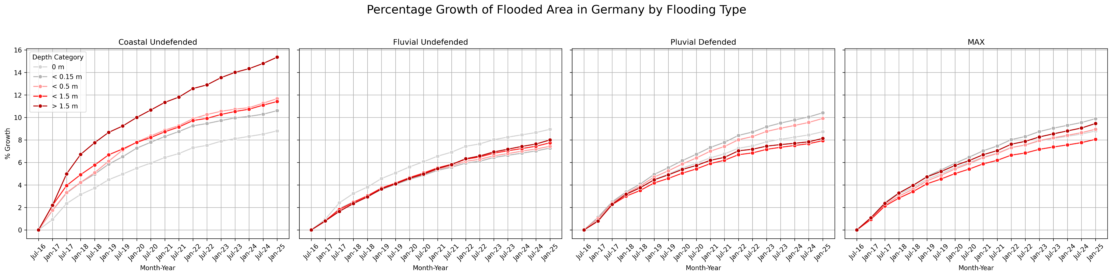

Slide 2
Summary of all Gemeinden included:
Flood Type | Total Exposed Area (sq km)
Coastal (CU) | 152.6109
Fluvial (FU) | 655.7197
Pluvial (PD) | 170.2653
Total exposed area to coastal flooding (>0.5 m) in Gemeinden subject mainly to coastal flooding
Total exposed area to fluvial flooding (>0.5 m) in Gemeinden subject mainly to fluvial flooding
Total exposed area to pluvial flooding (>0.5 m) in Gemeinden subject mainly to pluvial flooding
Put it in the text only, note how you summed the numbers

Slide 3
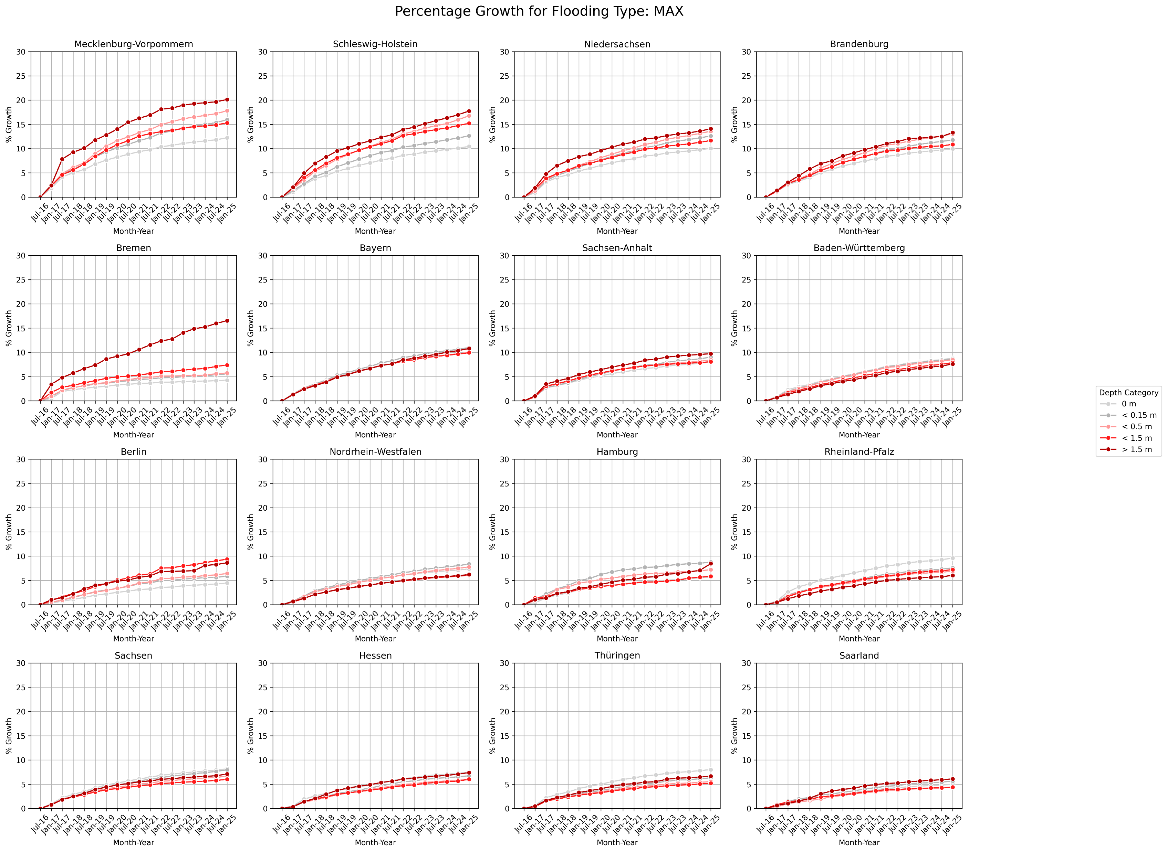
Combined Flooding,
See appendices for different flooding types
How they are sorted

Slide 4
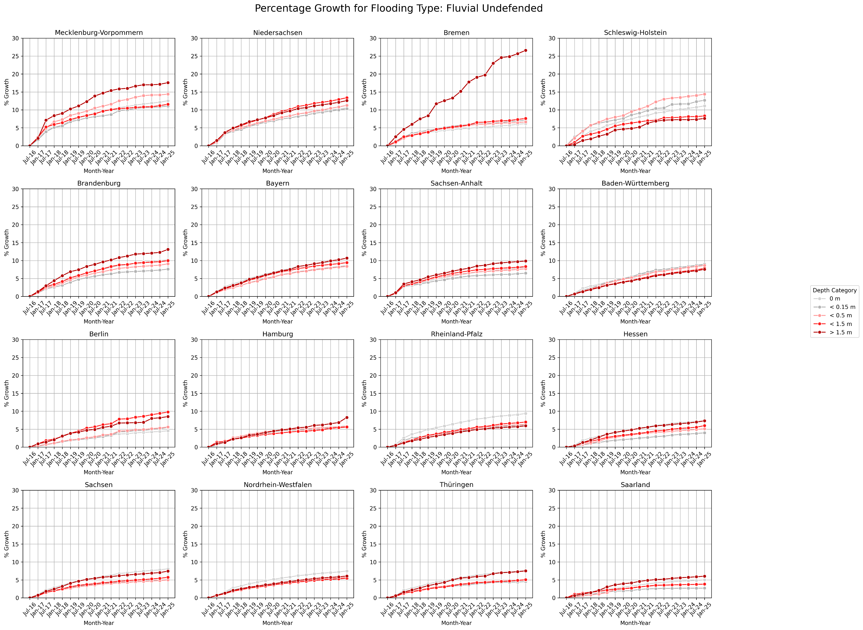
How they are sorted

Slide 5
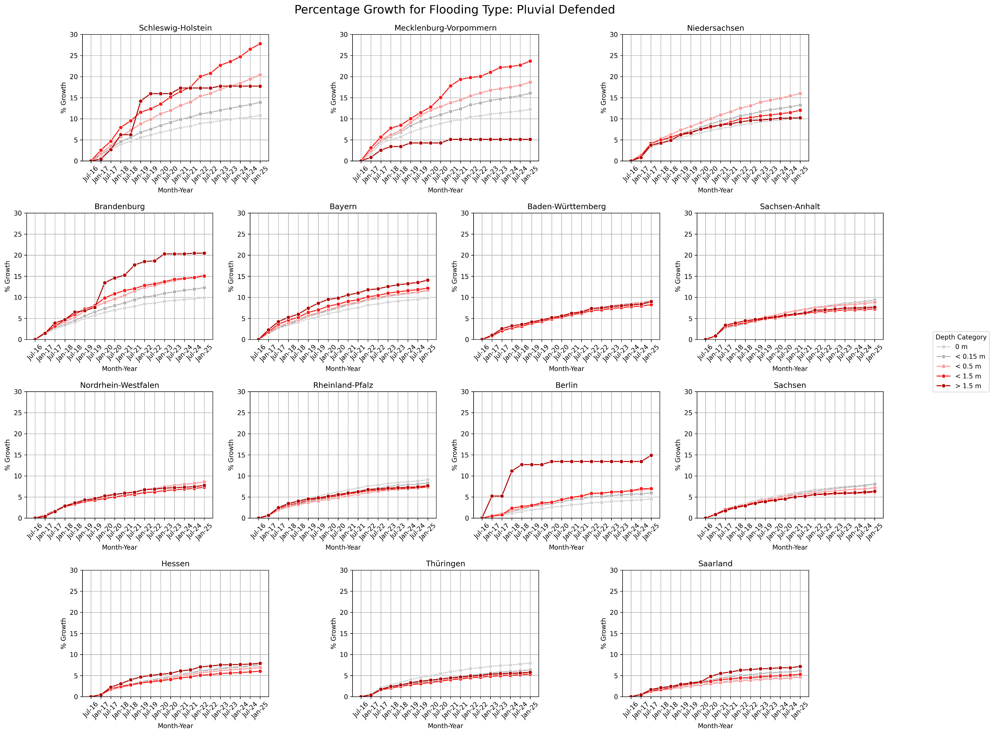

Slide 6
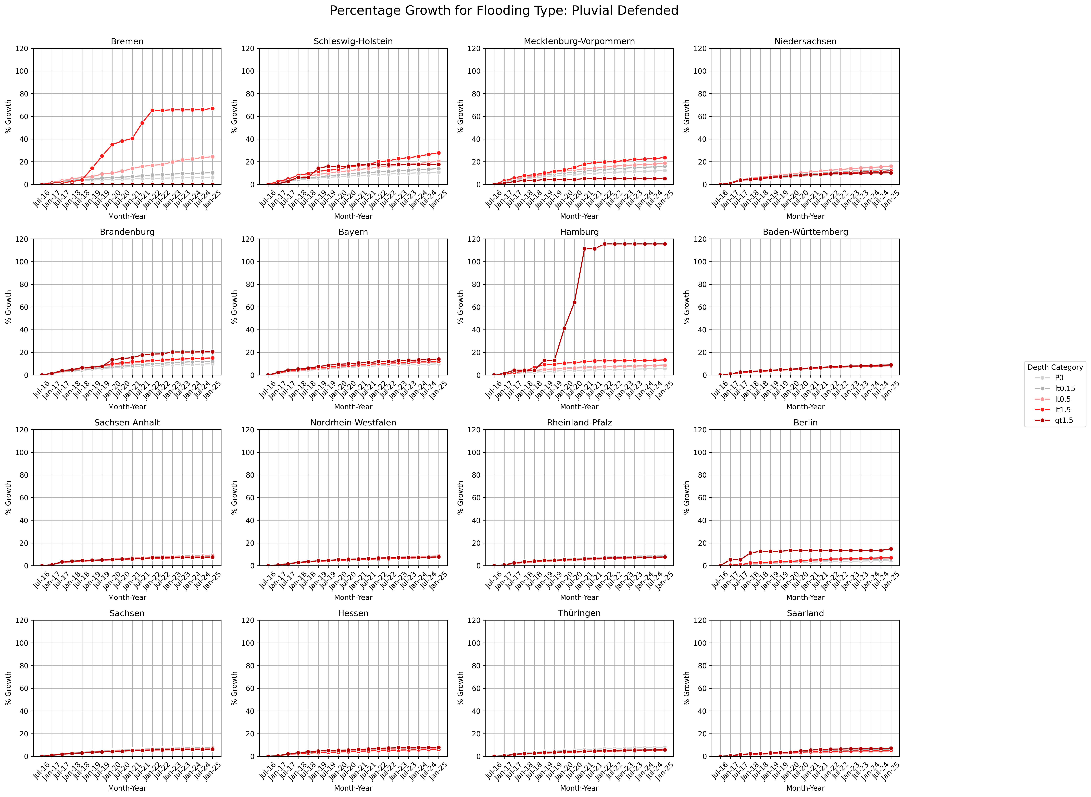
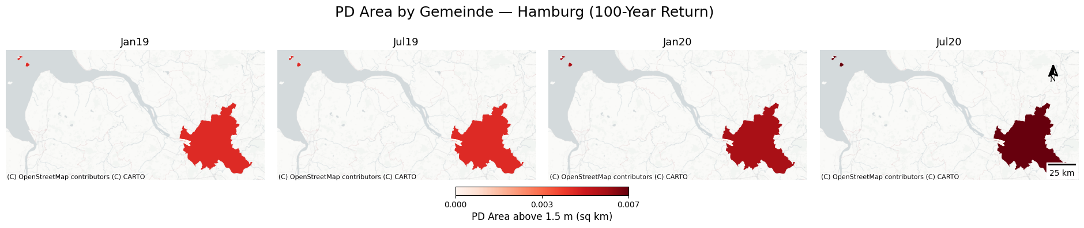
Explain them in the appendices, text only
Hamburg is not included in the percentage growth of settlement area under the pluvial flooding scenario, as only a small area experienced a substantial percentage increase in flooding depth exceeding 1.5 meters.

Slide 7
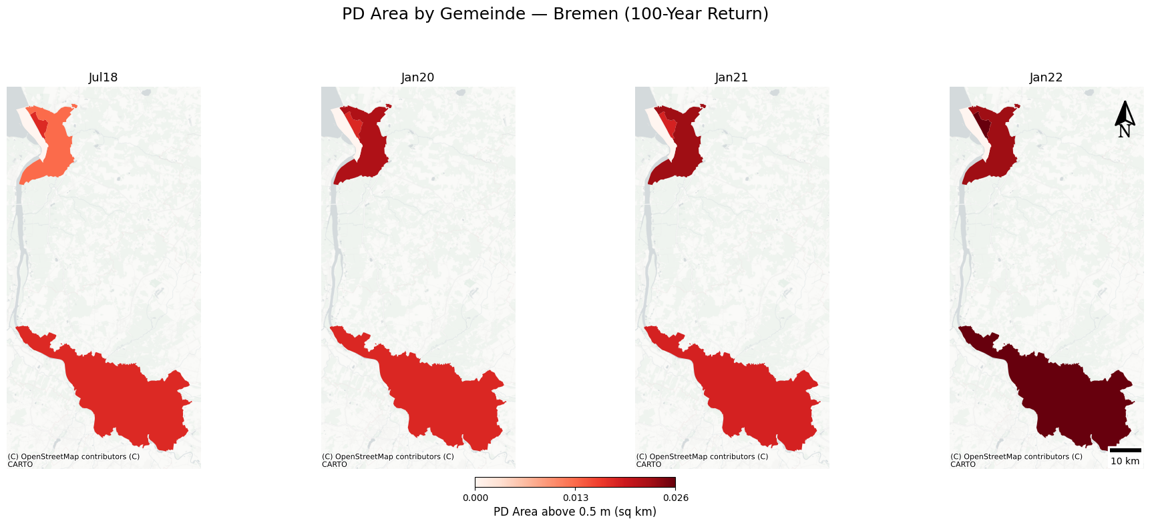
Explain them in the appendices, text only
Bremen is not included for a similar reason; only a small area experienced a substantial percentage increase in flooding depth exceeding 0.5 meters.

Slide 8
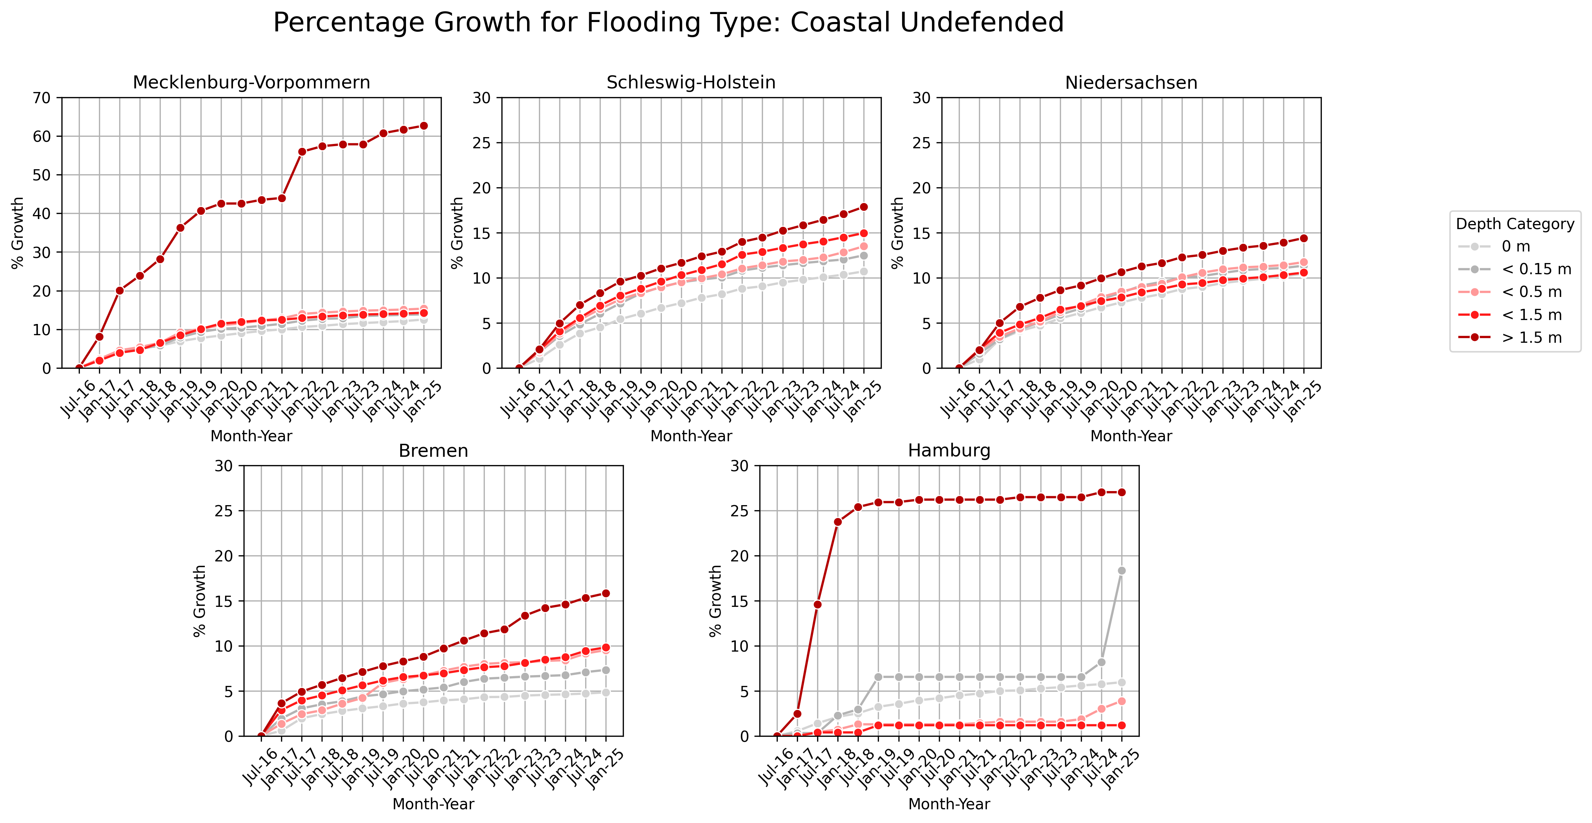

Slide 9
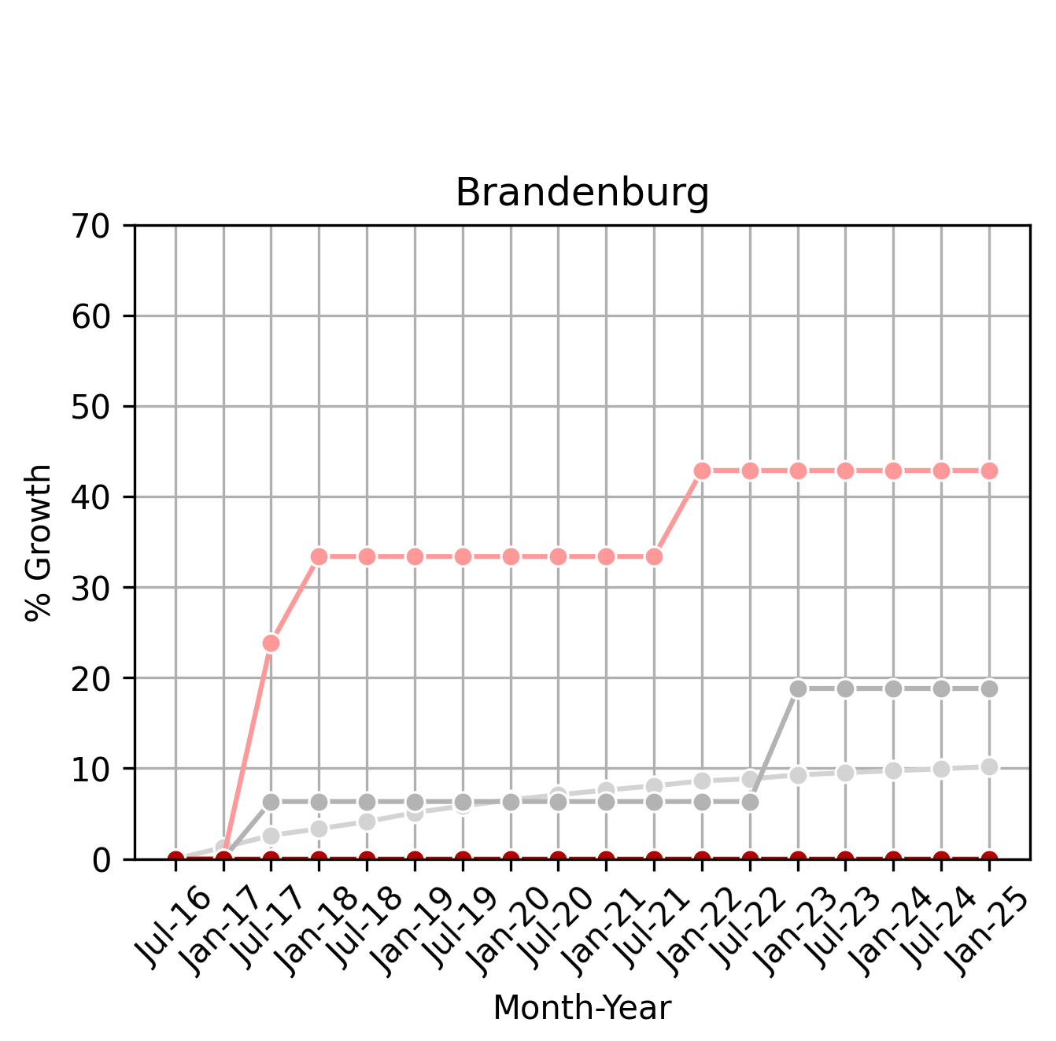
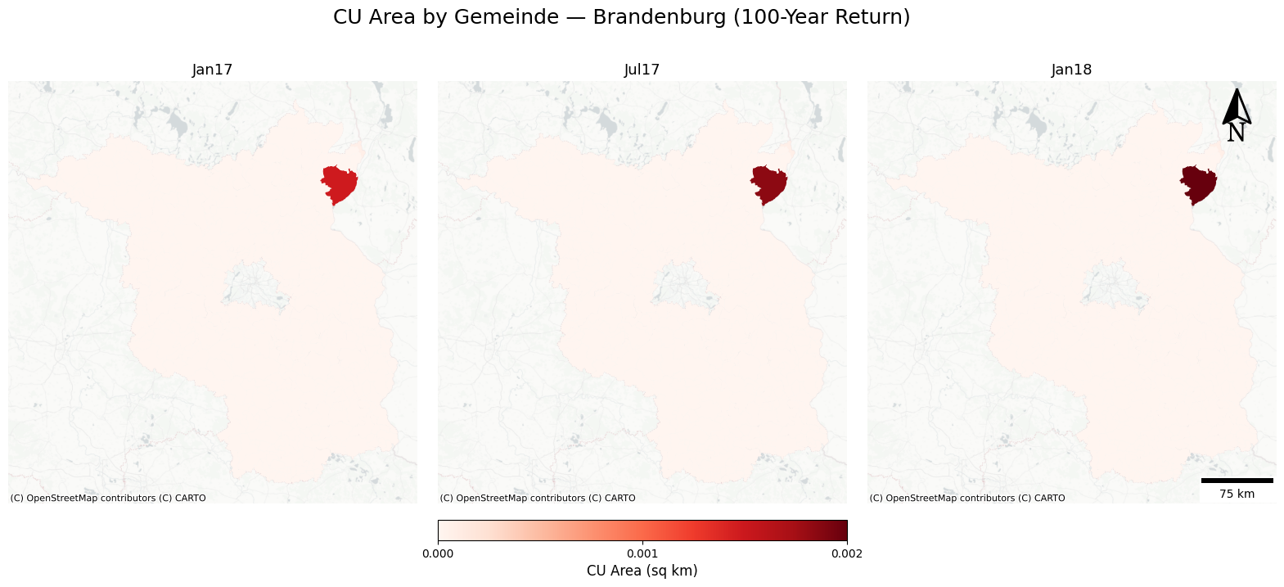
Same for Brandenburg under the coastal flooding scenario.
(flooding depth between 0.15 m and 0.5 m)
Explain them in the appendices, text only

Slide 10
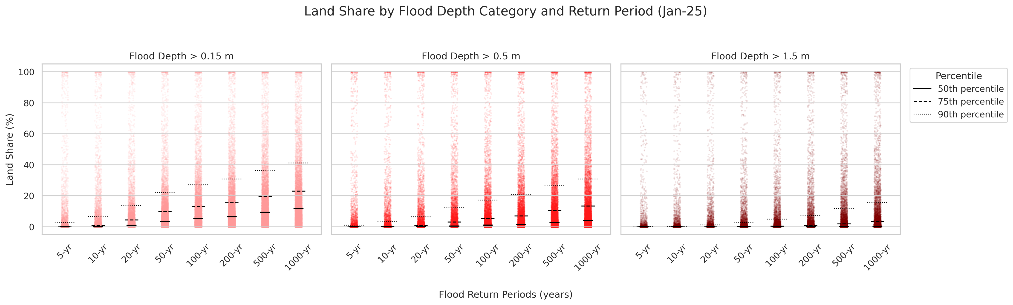
Clarify in the title: max flooding
Exposure rising in many lands (from previous plots)
Break down to Gemeinden level: median of the exposure, and extreme cases: 100% especially in the > 1.5 m level,
return period, also pay attention to high-frequency, though low intensity events (here some Gemeinden have 100% exposure risk to extreme flooding depth, frequently),
highlight both though, (high-frequency&low intensity events; low frequency&high intensity)
Put the y-axis percentile numbers in the text

Slide 11
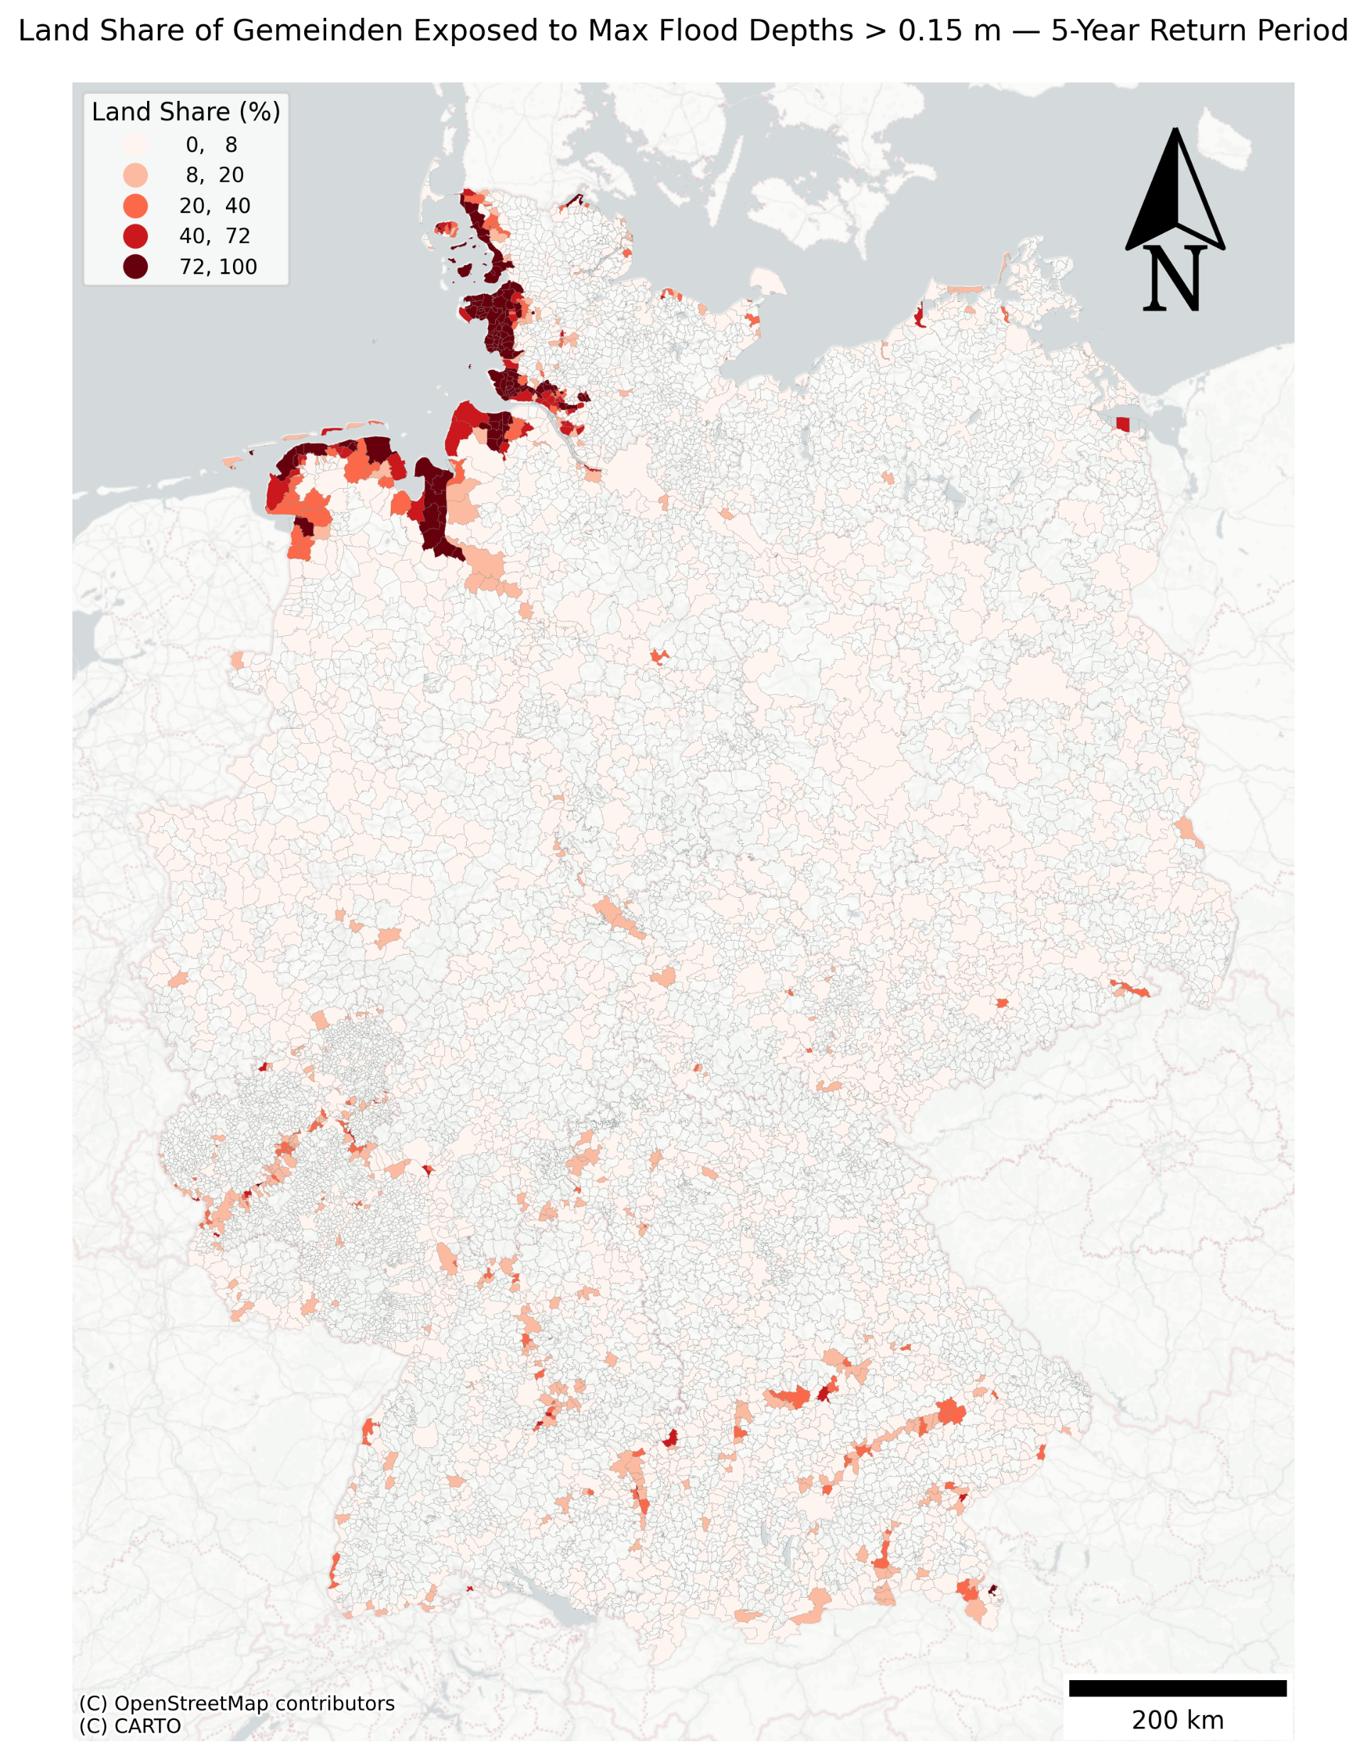

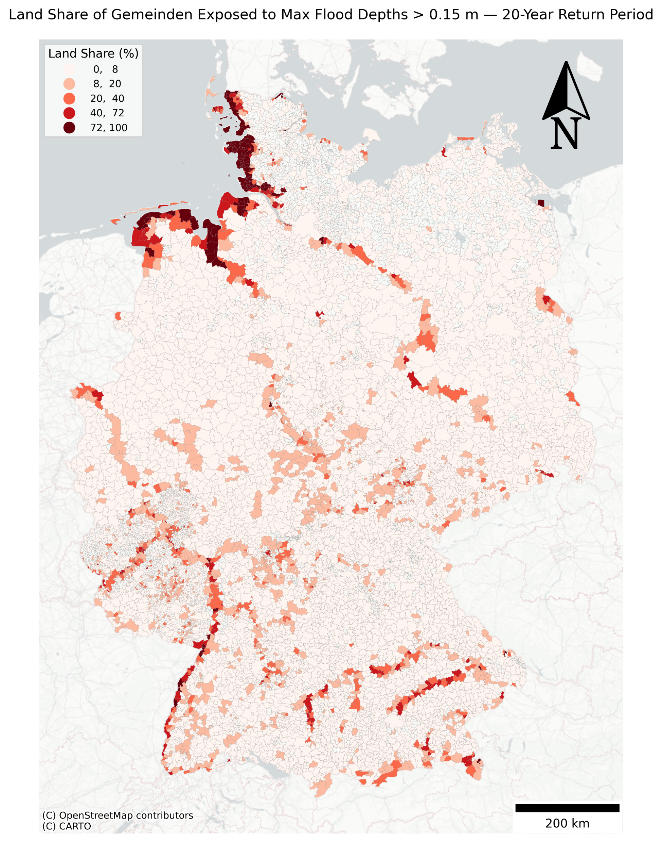
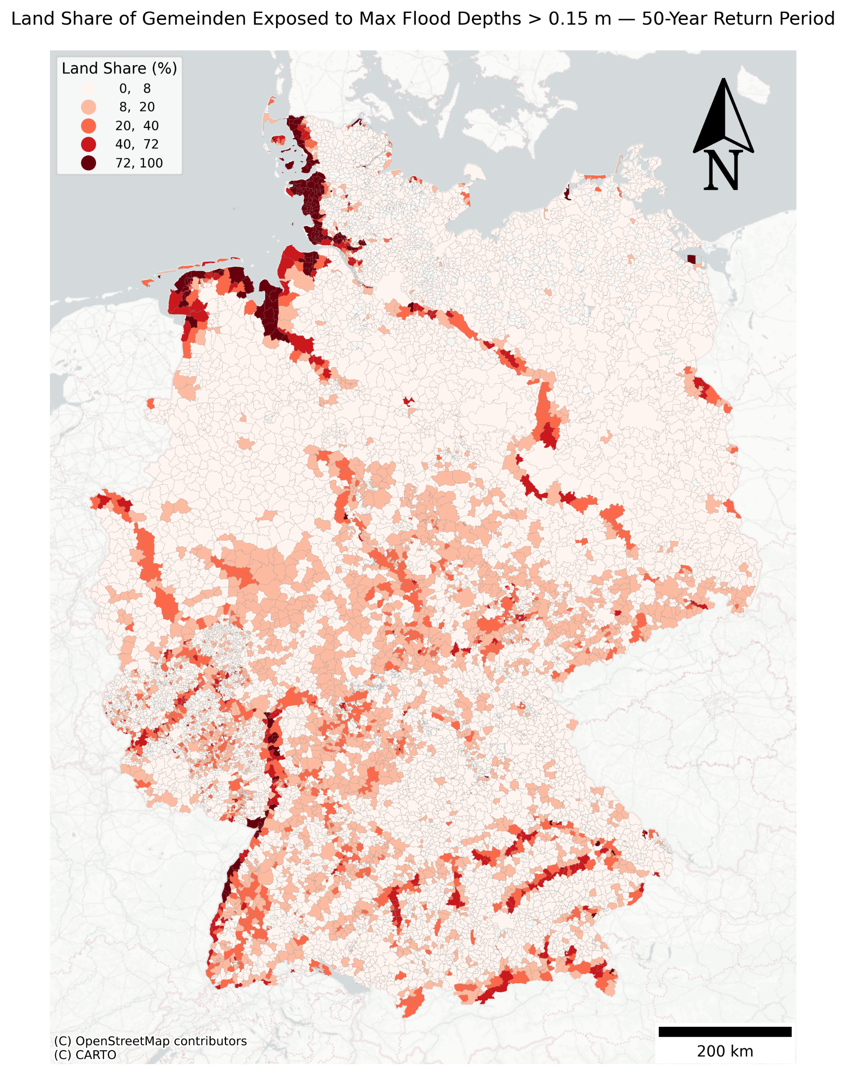

Main: 10, 50, 100, 500
All map together in appendix
Clarify in title: max flooding

Slide 12
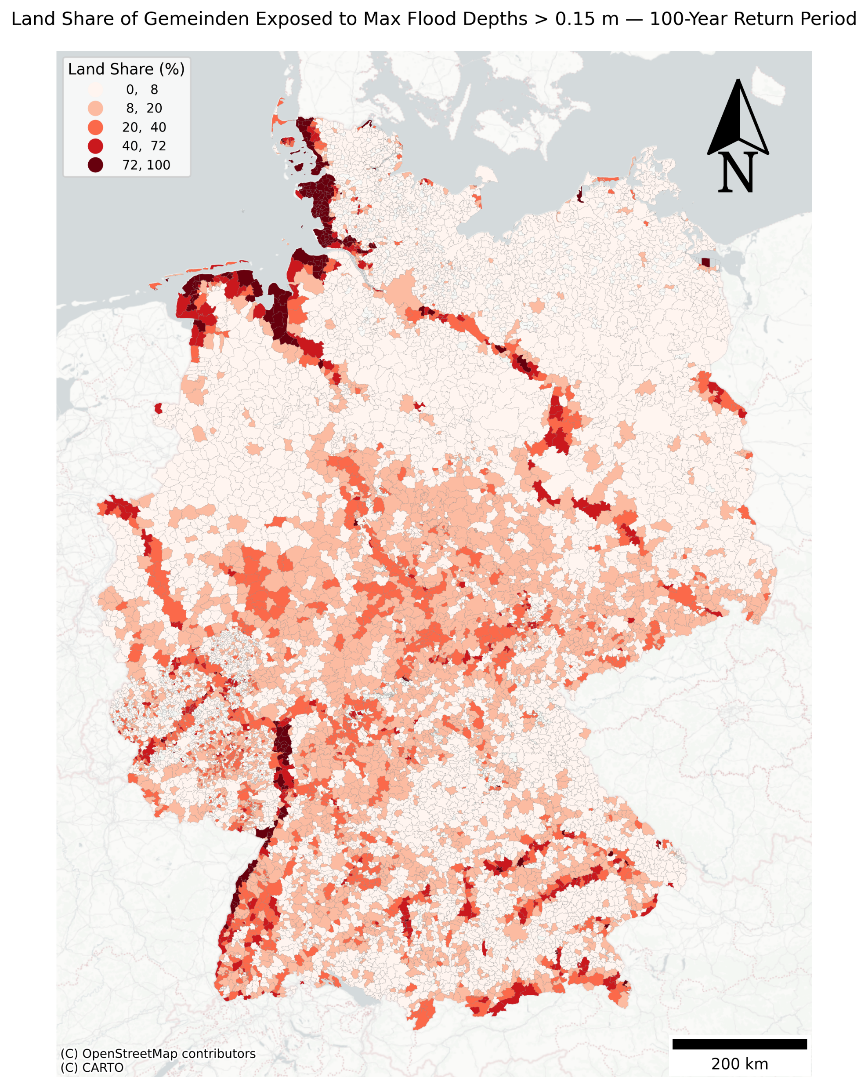
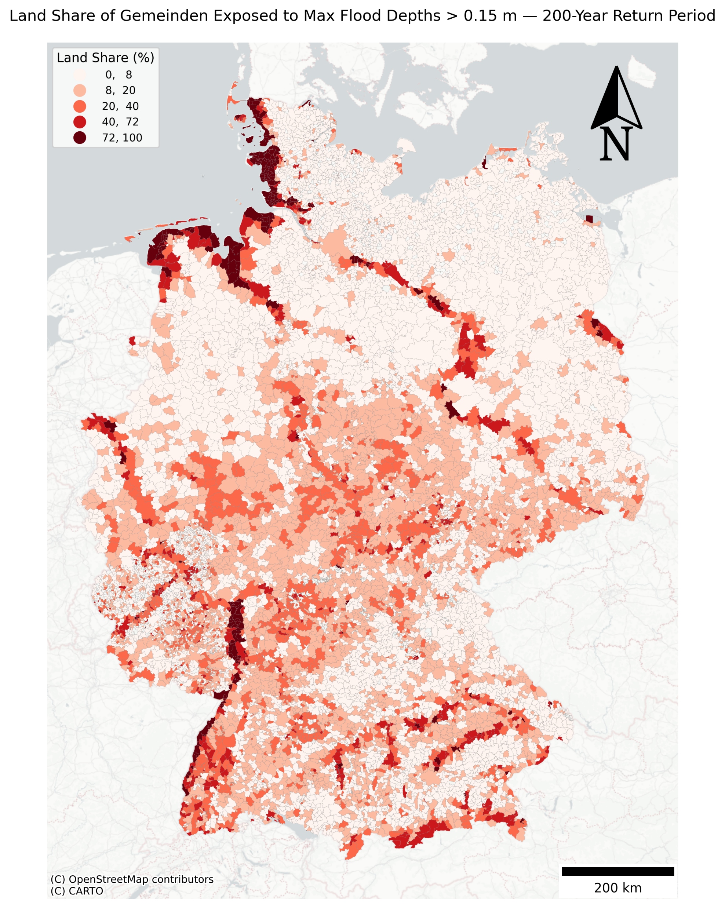
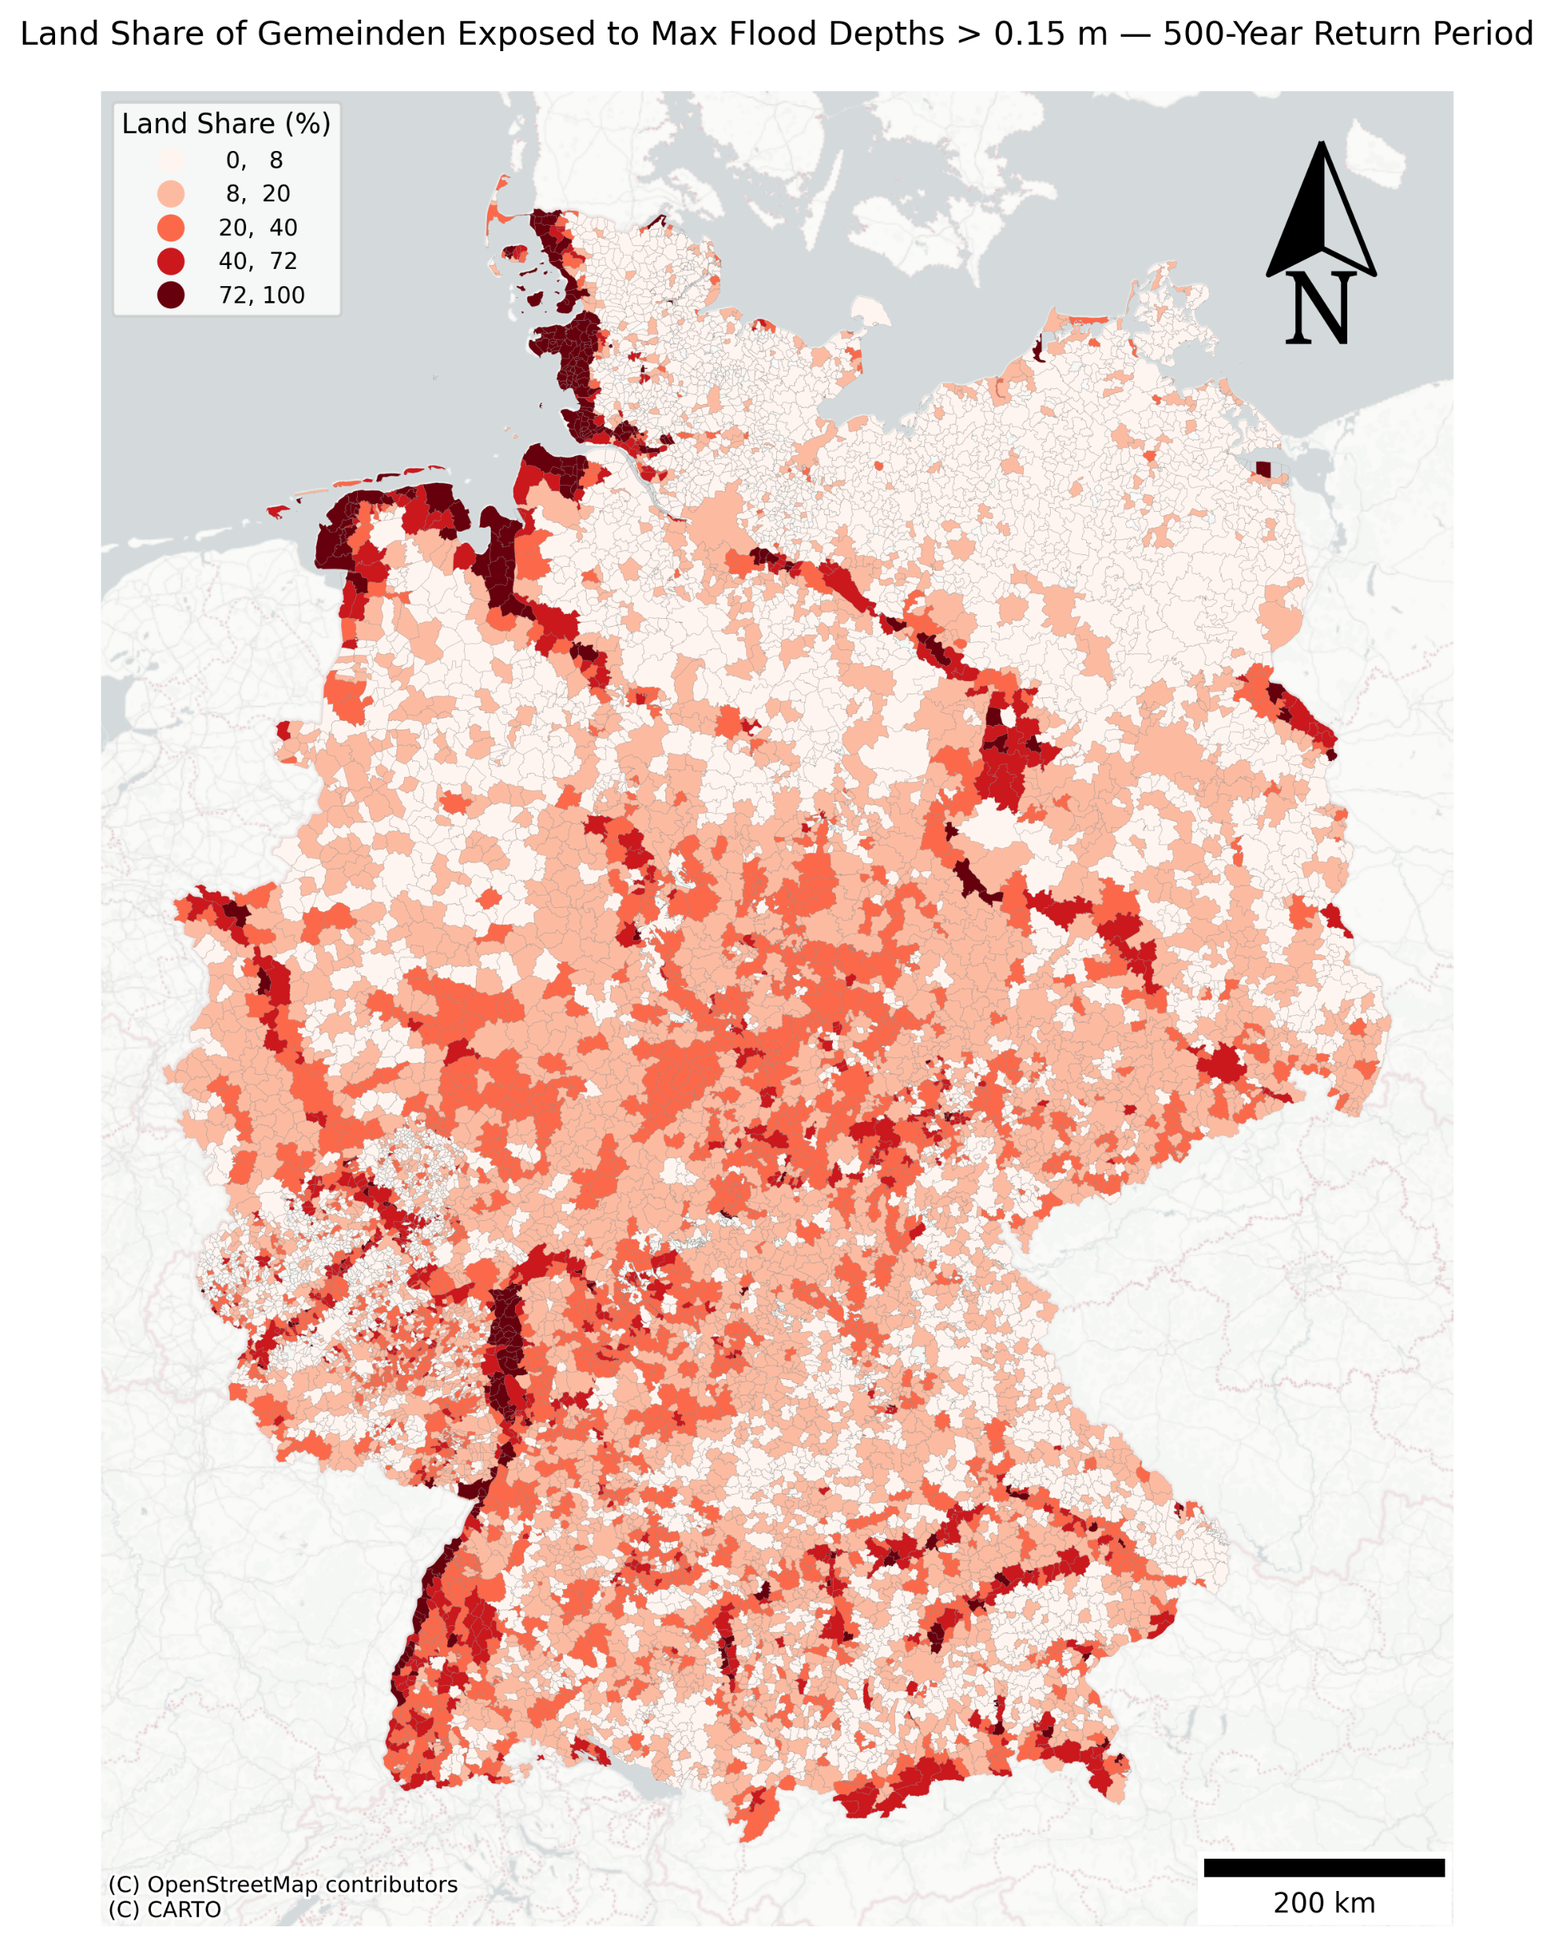
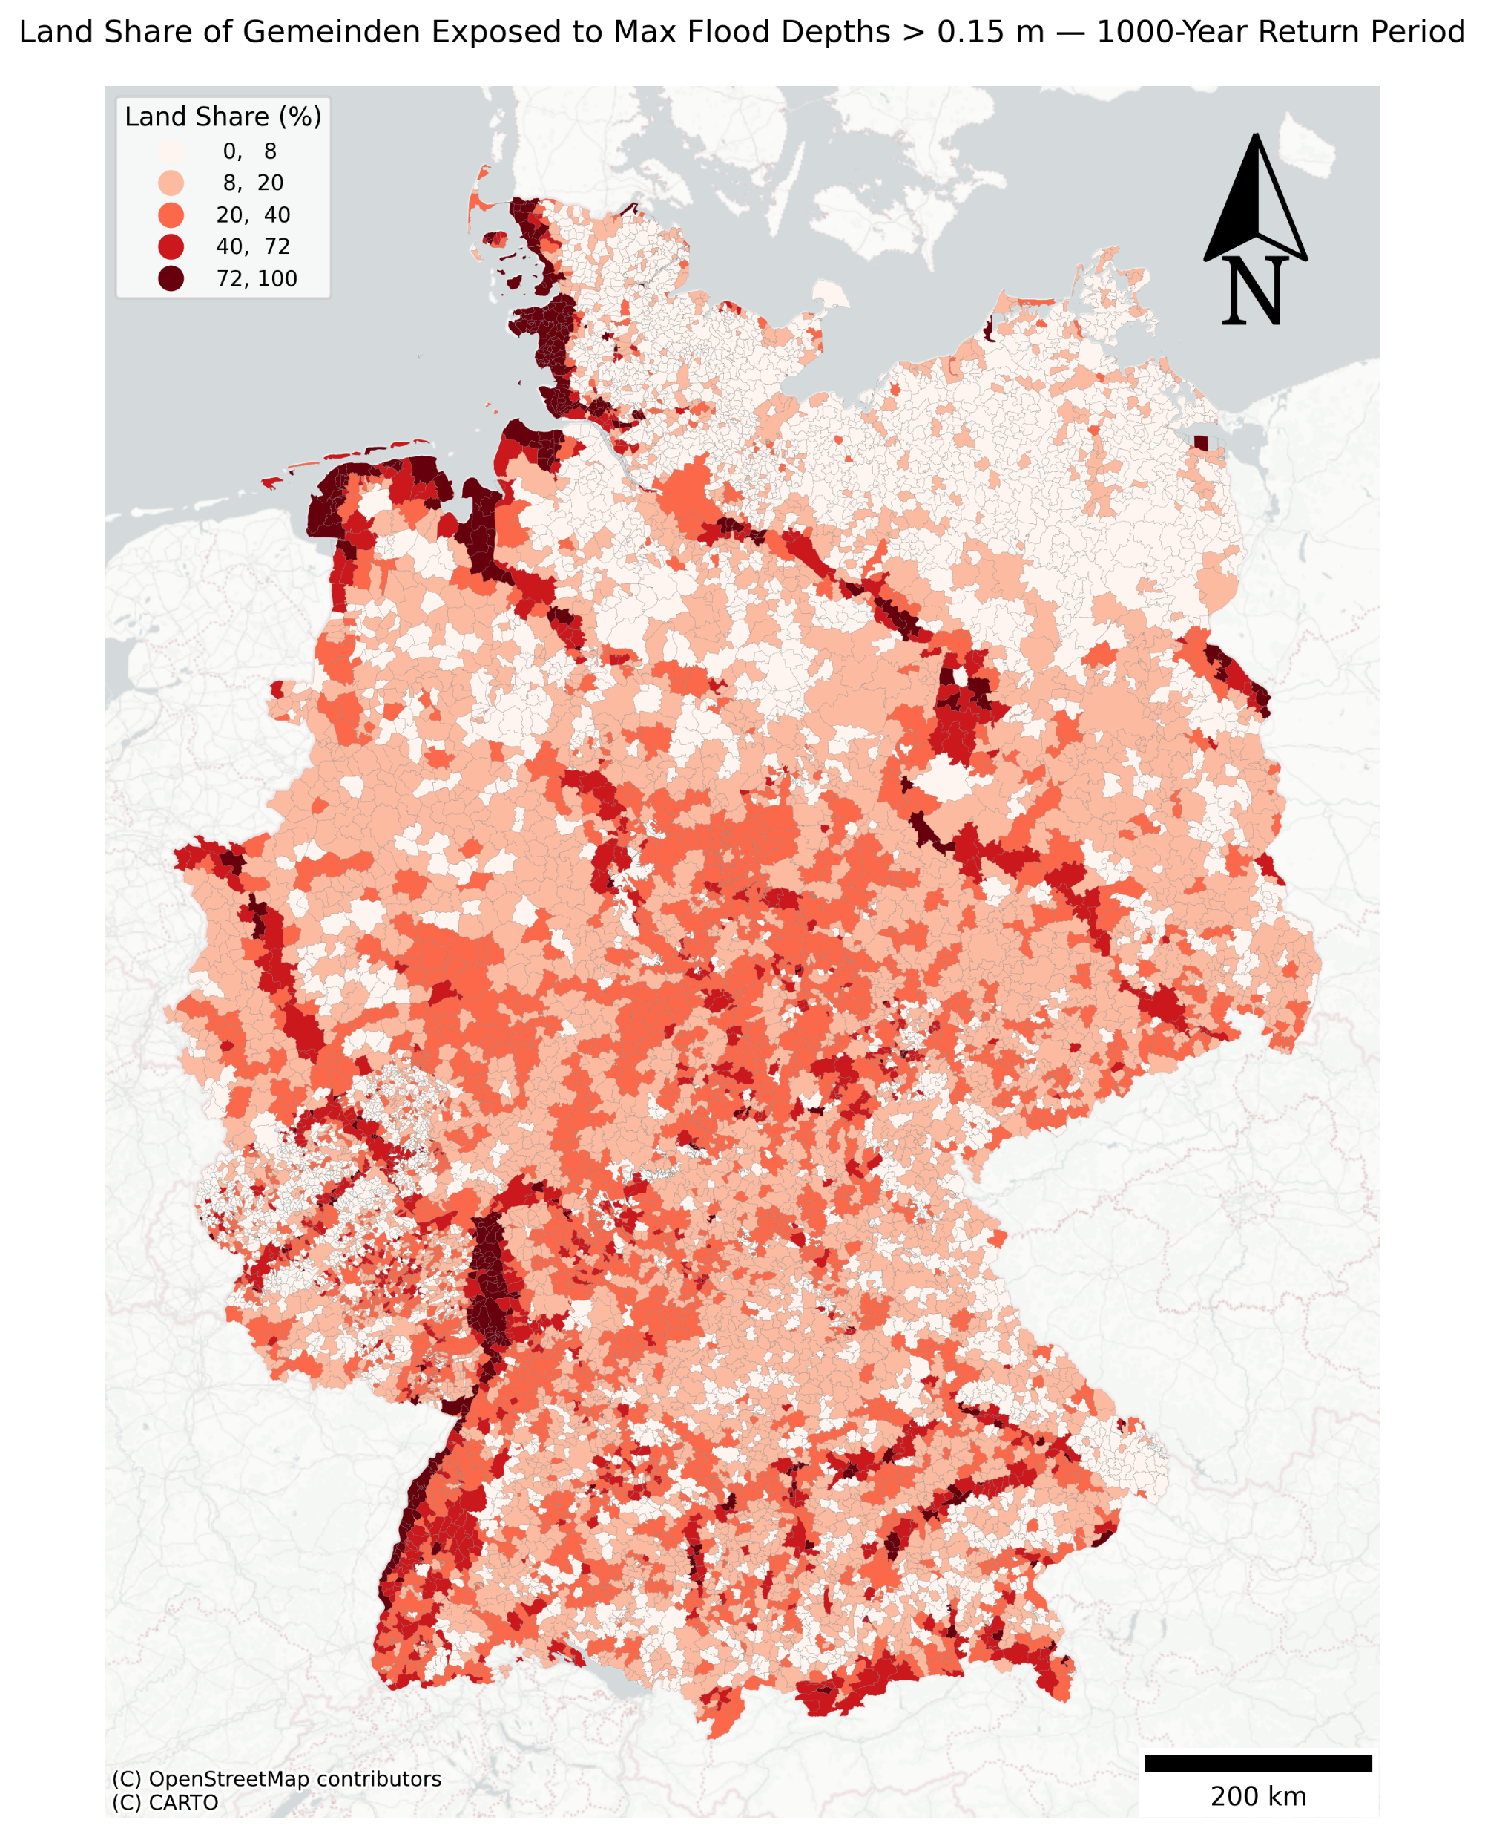
Exposure particularly high in the river basins and along the coast, and far south close to the mountains: spatial pattern of the high share of the exposure, keep it simple
Clarify in title: max flooding

Slide 13
New map: pct growth for all Gemeinden, (Jan-25 – Jul-16)/Jul-16
For all the return periods, max flooding, clarify in title
10, 50, 100, 500 in the main text, and all map together in the appendix

Slide 14
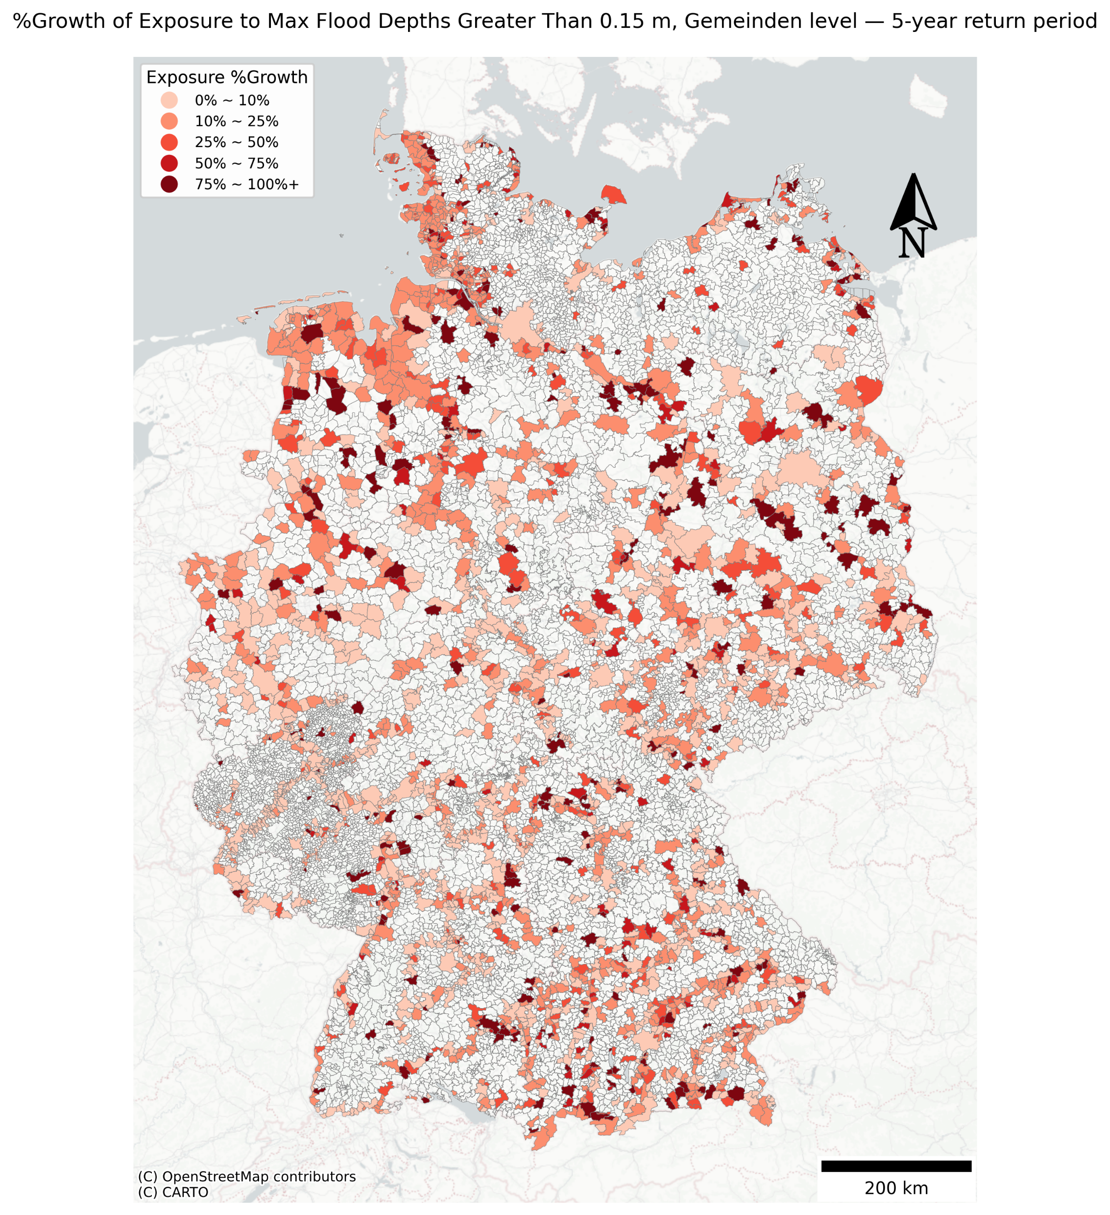
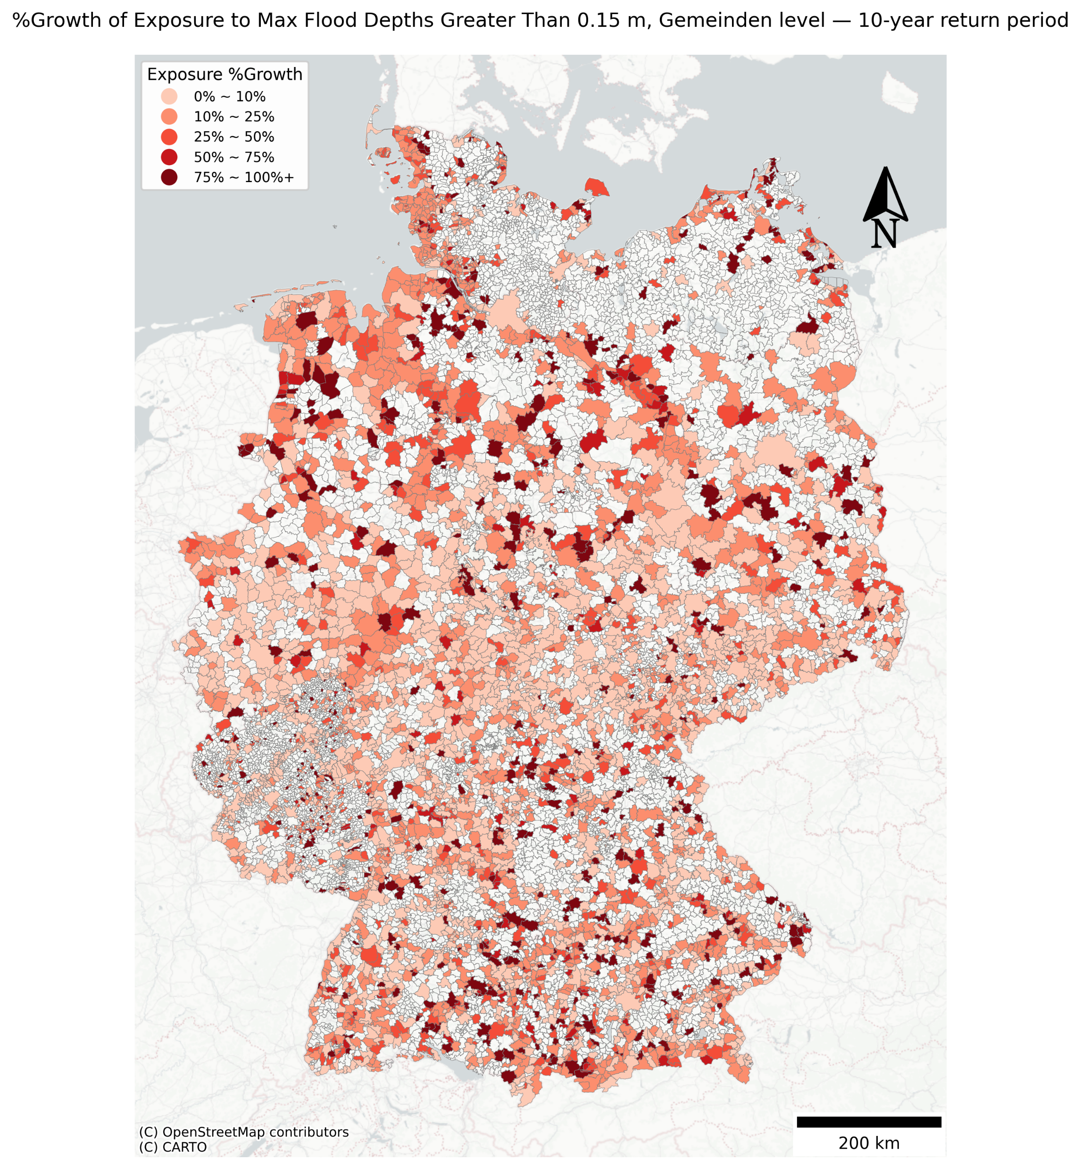
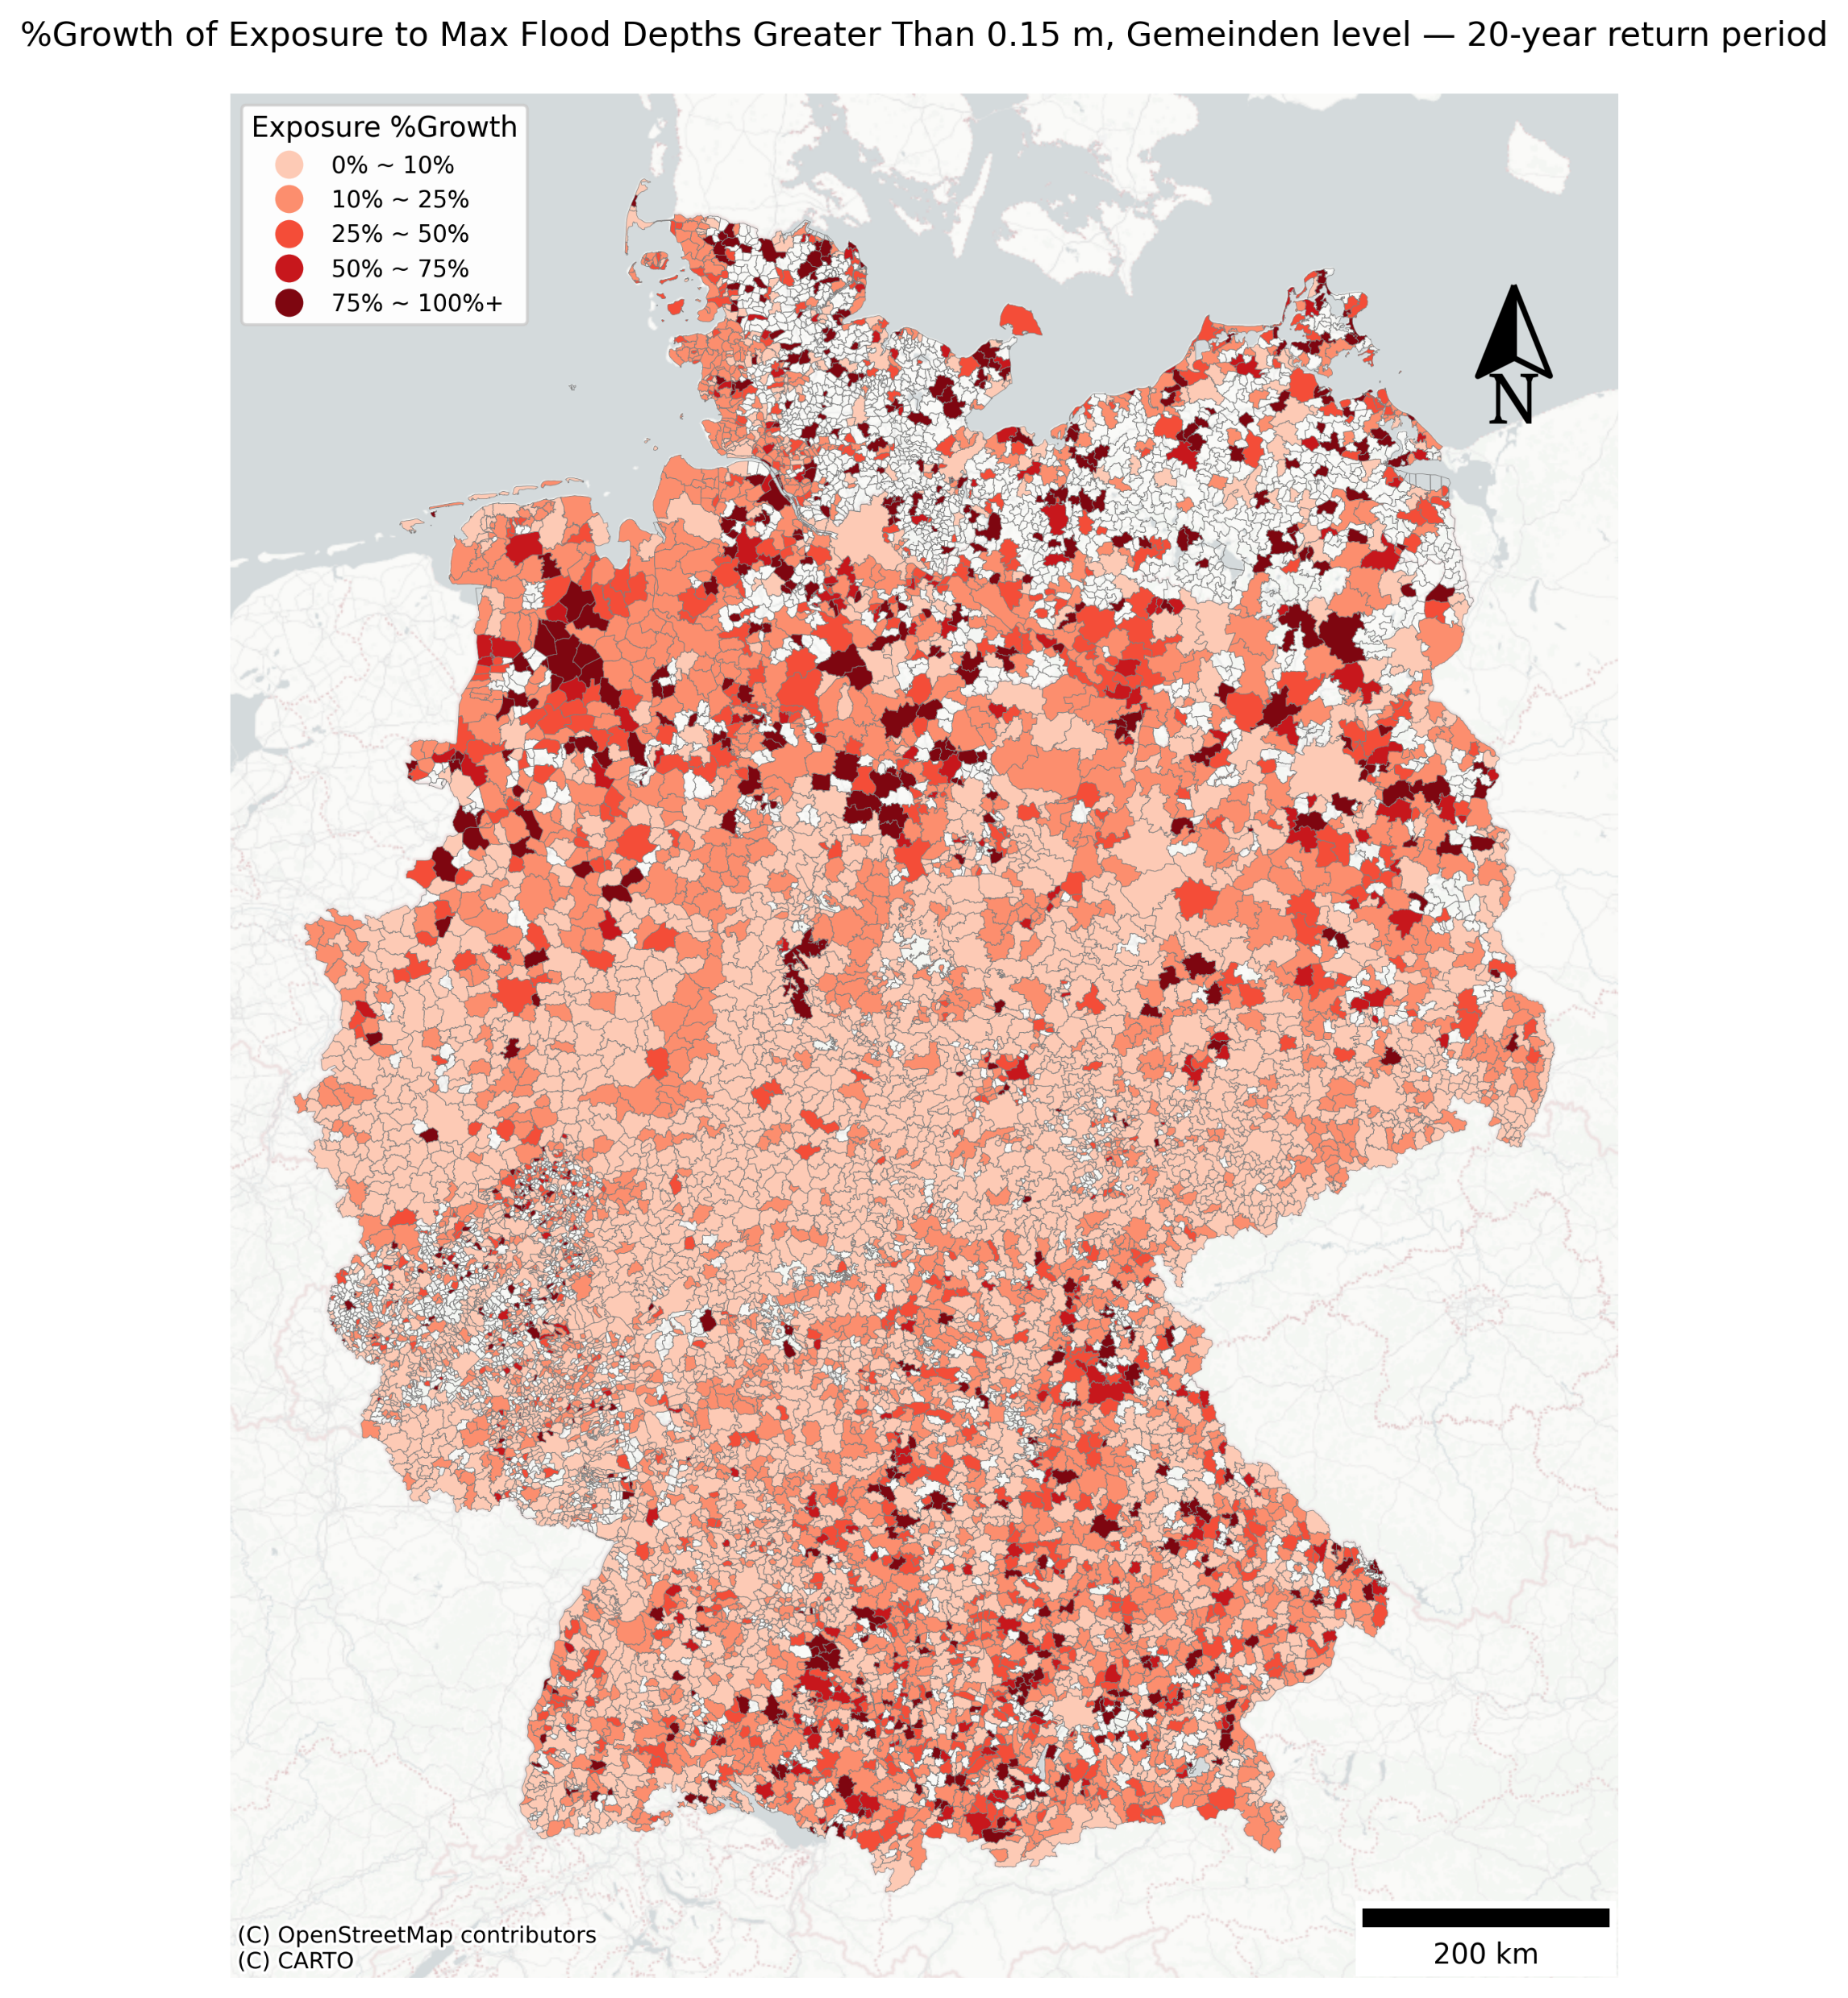
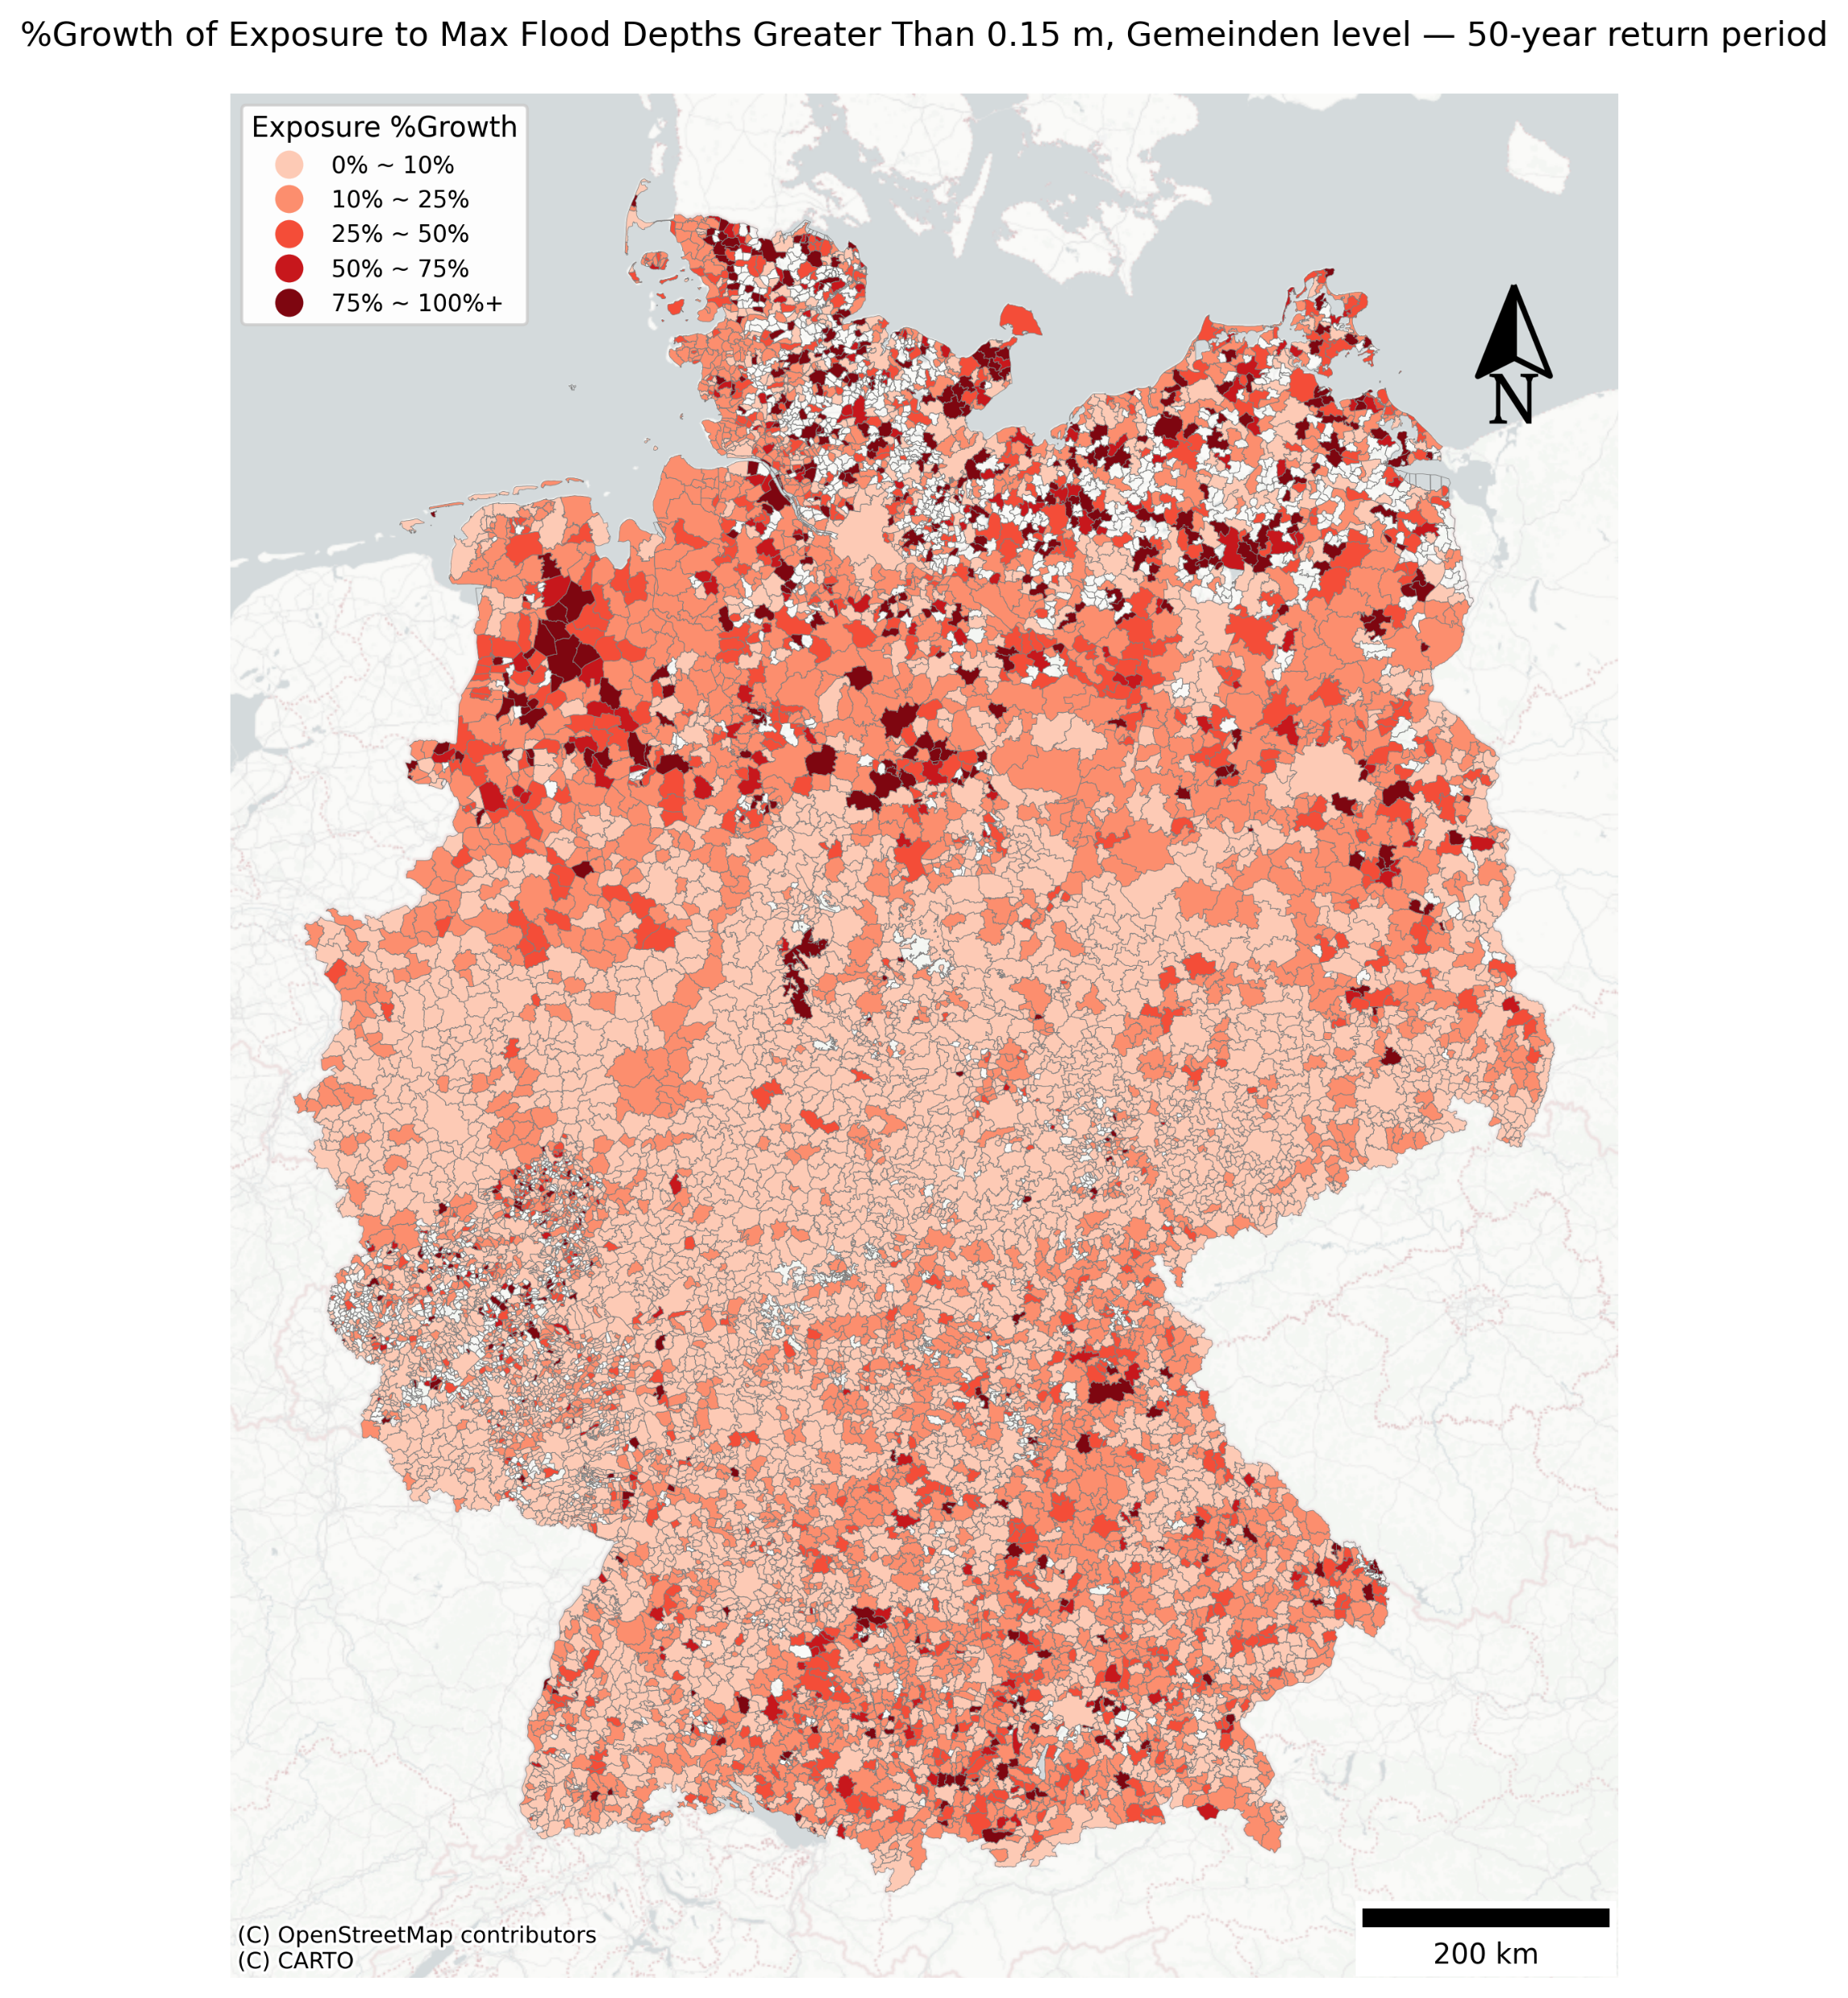
Customized break across return periods:
0 ~ 10%,
10~25%,
25~50%,
50~75%,
75~100+%
I also have quantile breaks saved for each map.

Slide 15
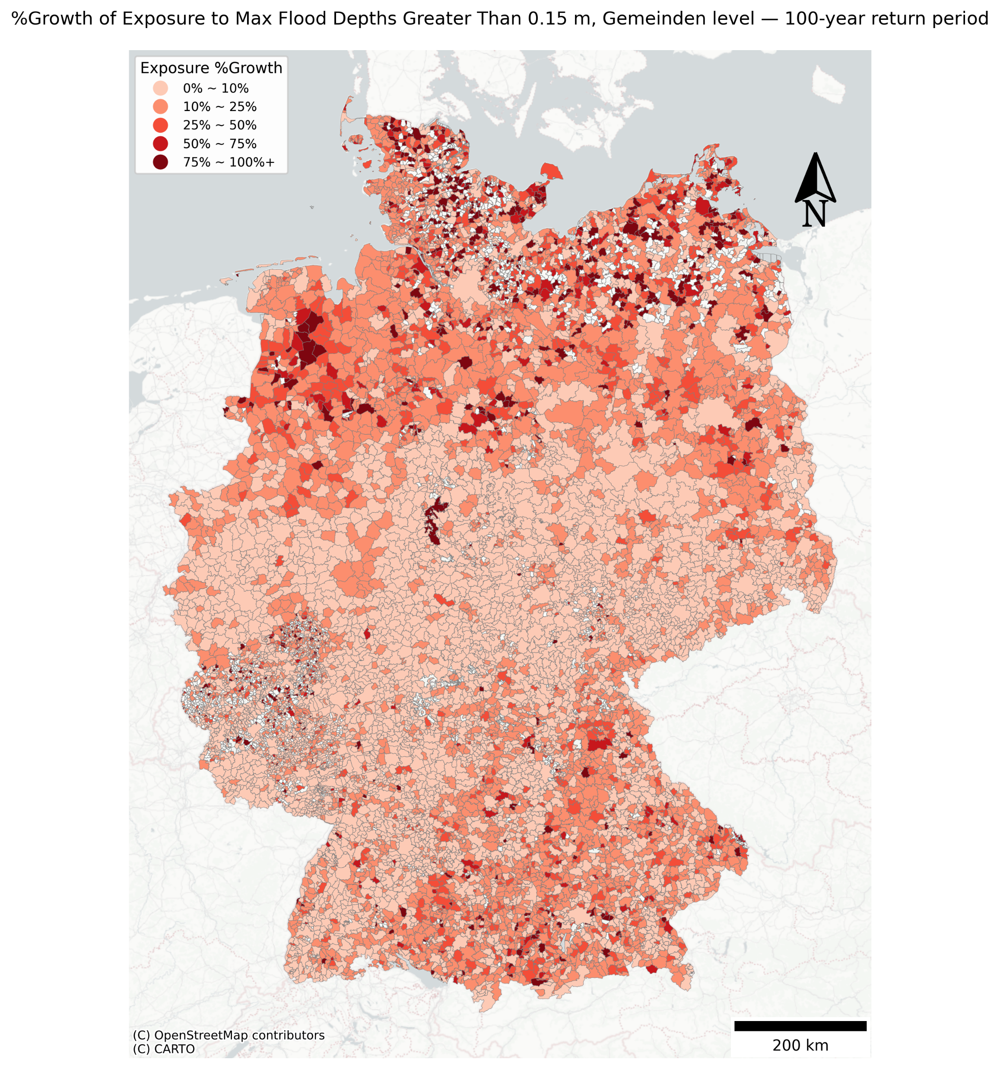
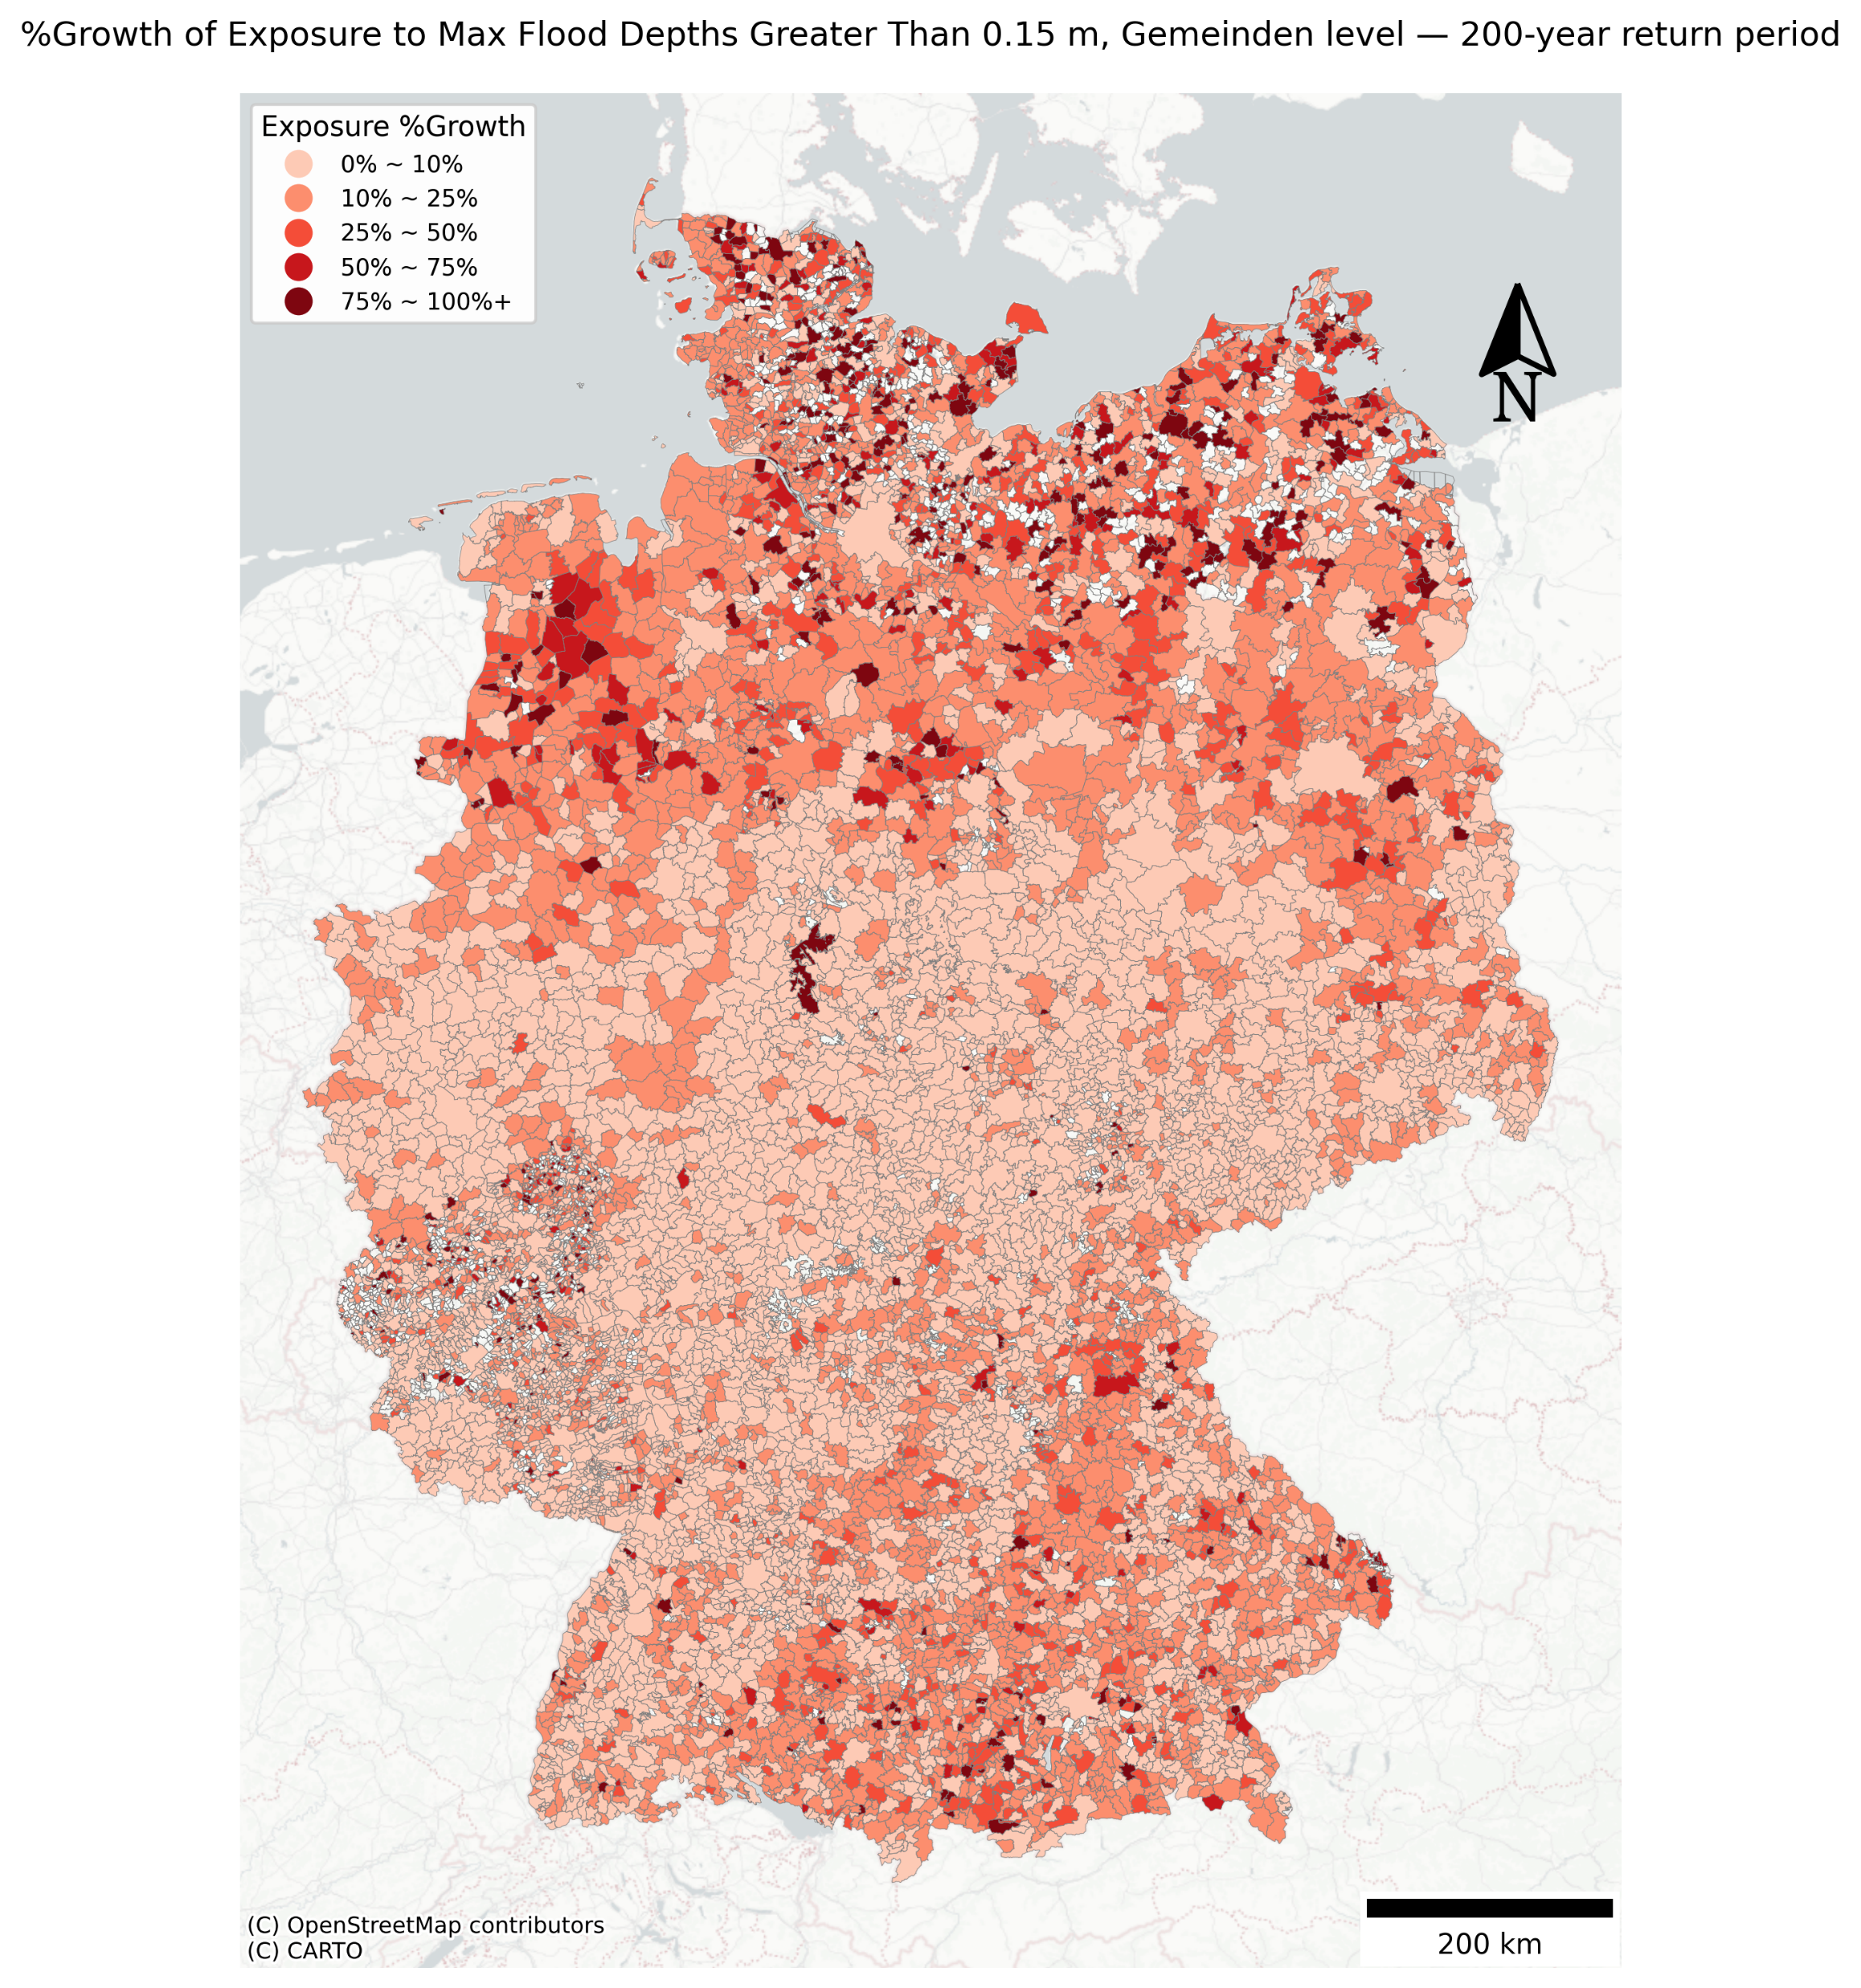

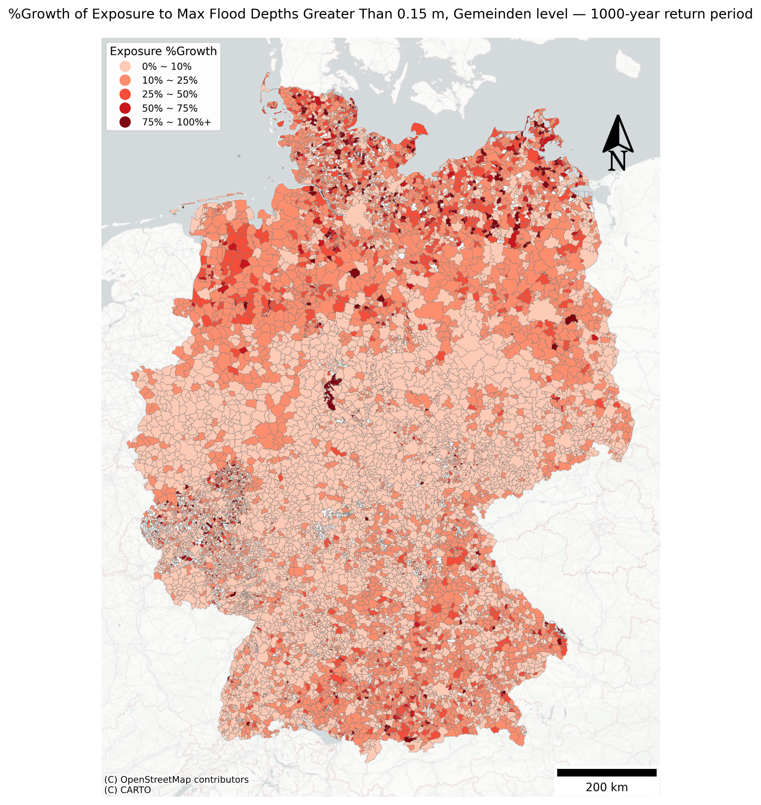

Slide 16
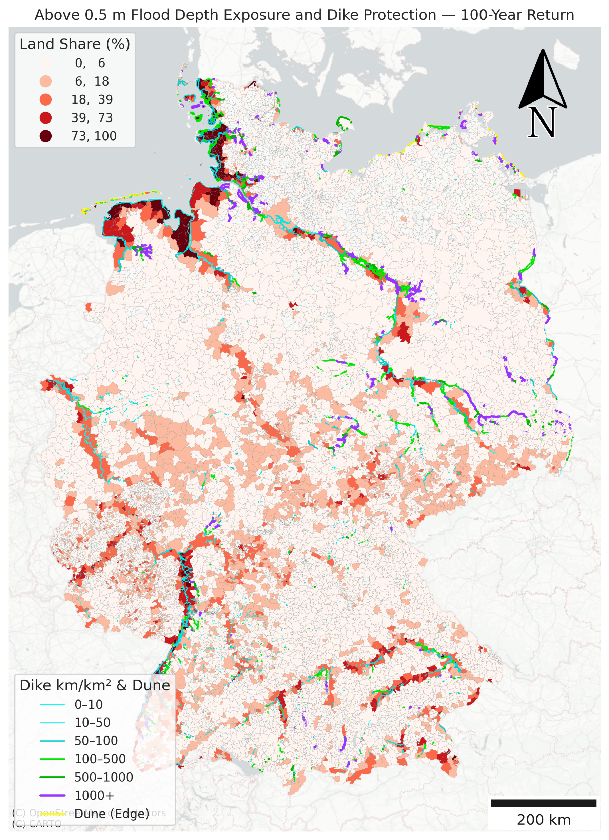
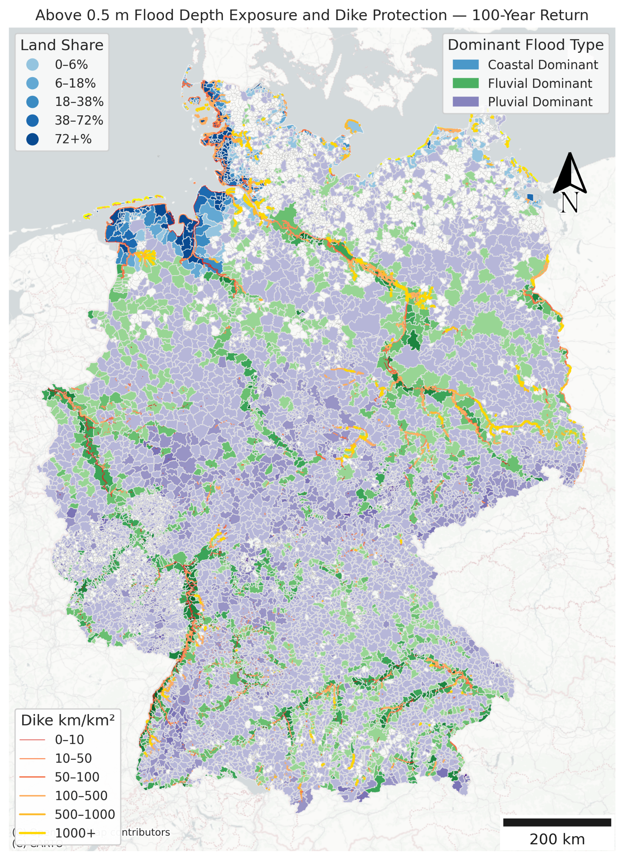

Just plot the dike shape without different colors and density breaks, plain black lines
Total length of currently constructed dike = 13237.16 km

Slide 17
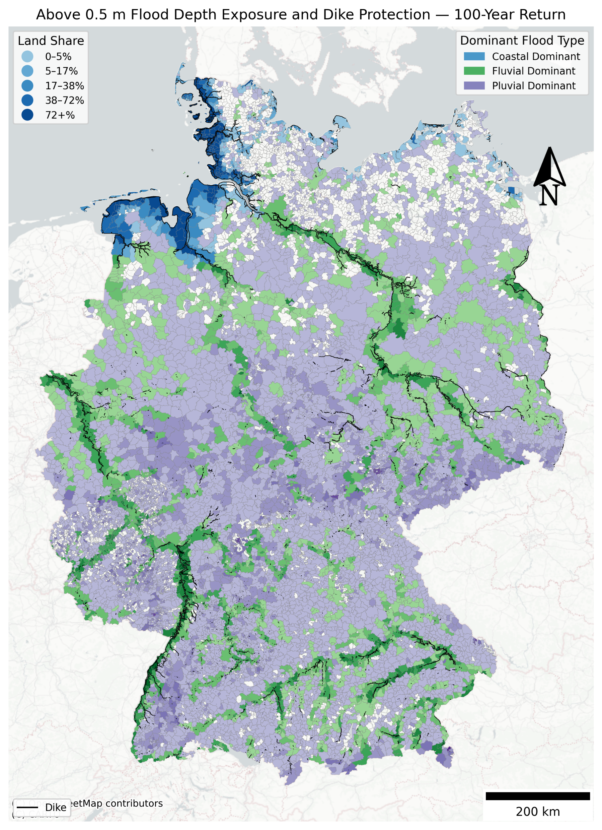

Slide 18
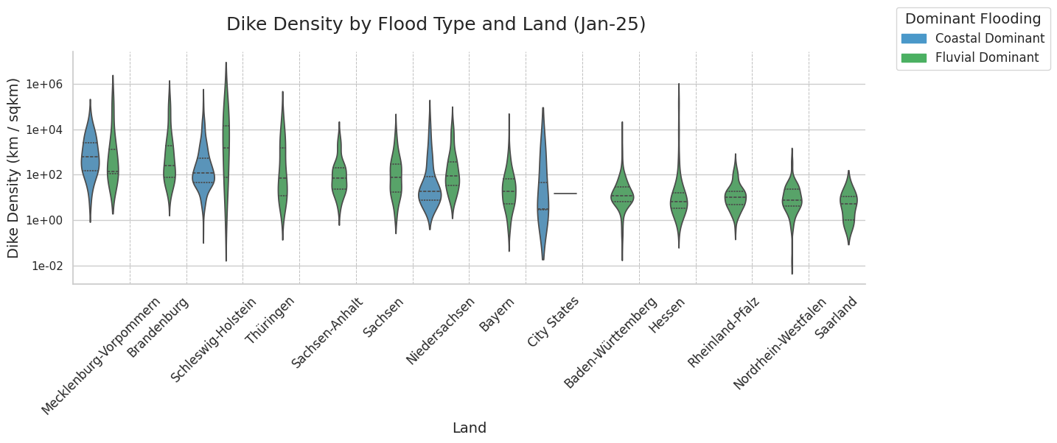
City State: Bremen, Berlin, Hamburg

Slide 19
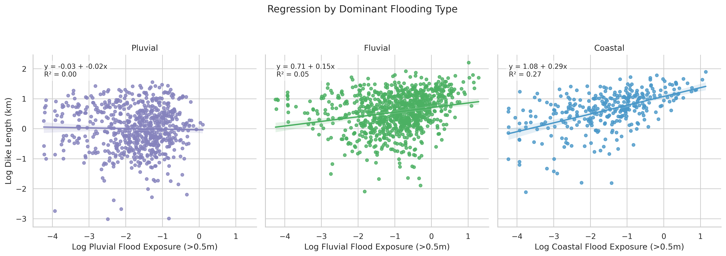
Increased exposure, increased dike density in general, but only for fluvial and coastal,
So that’s why we dropped pluvial in the dike density strip plot
To protect against pluvial flooding, other infrastructure would be more appropriate and we need more of them

Slide 20
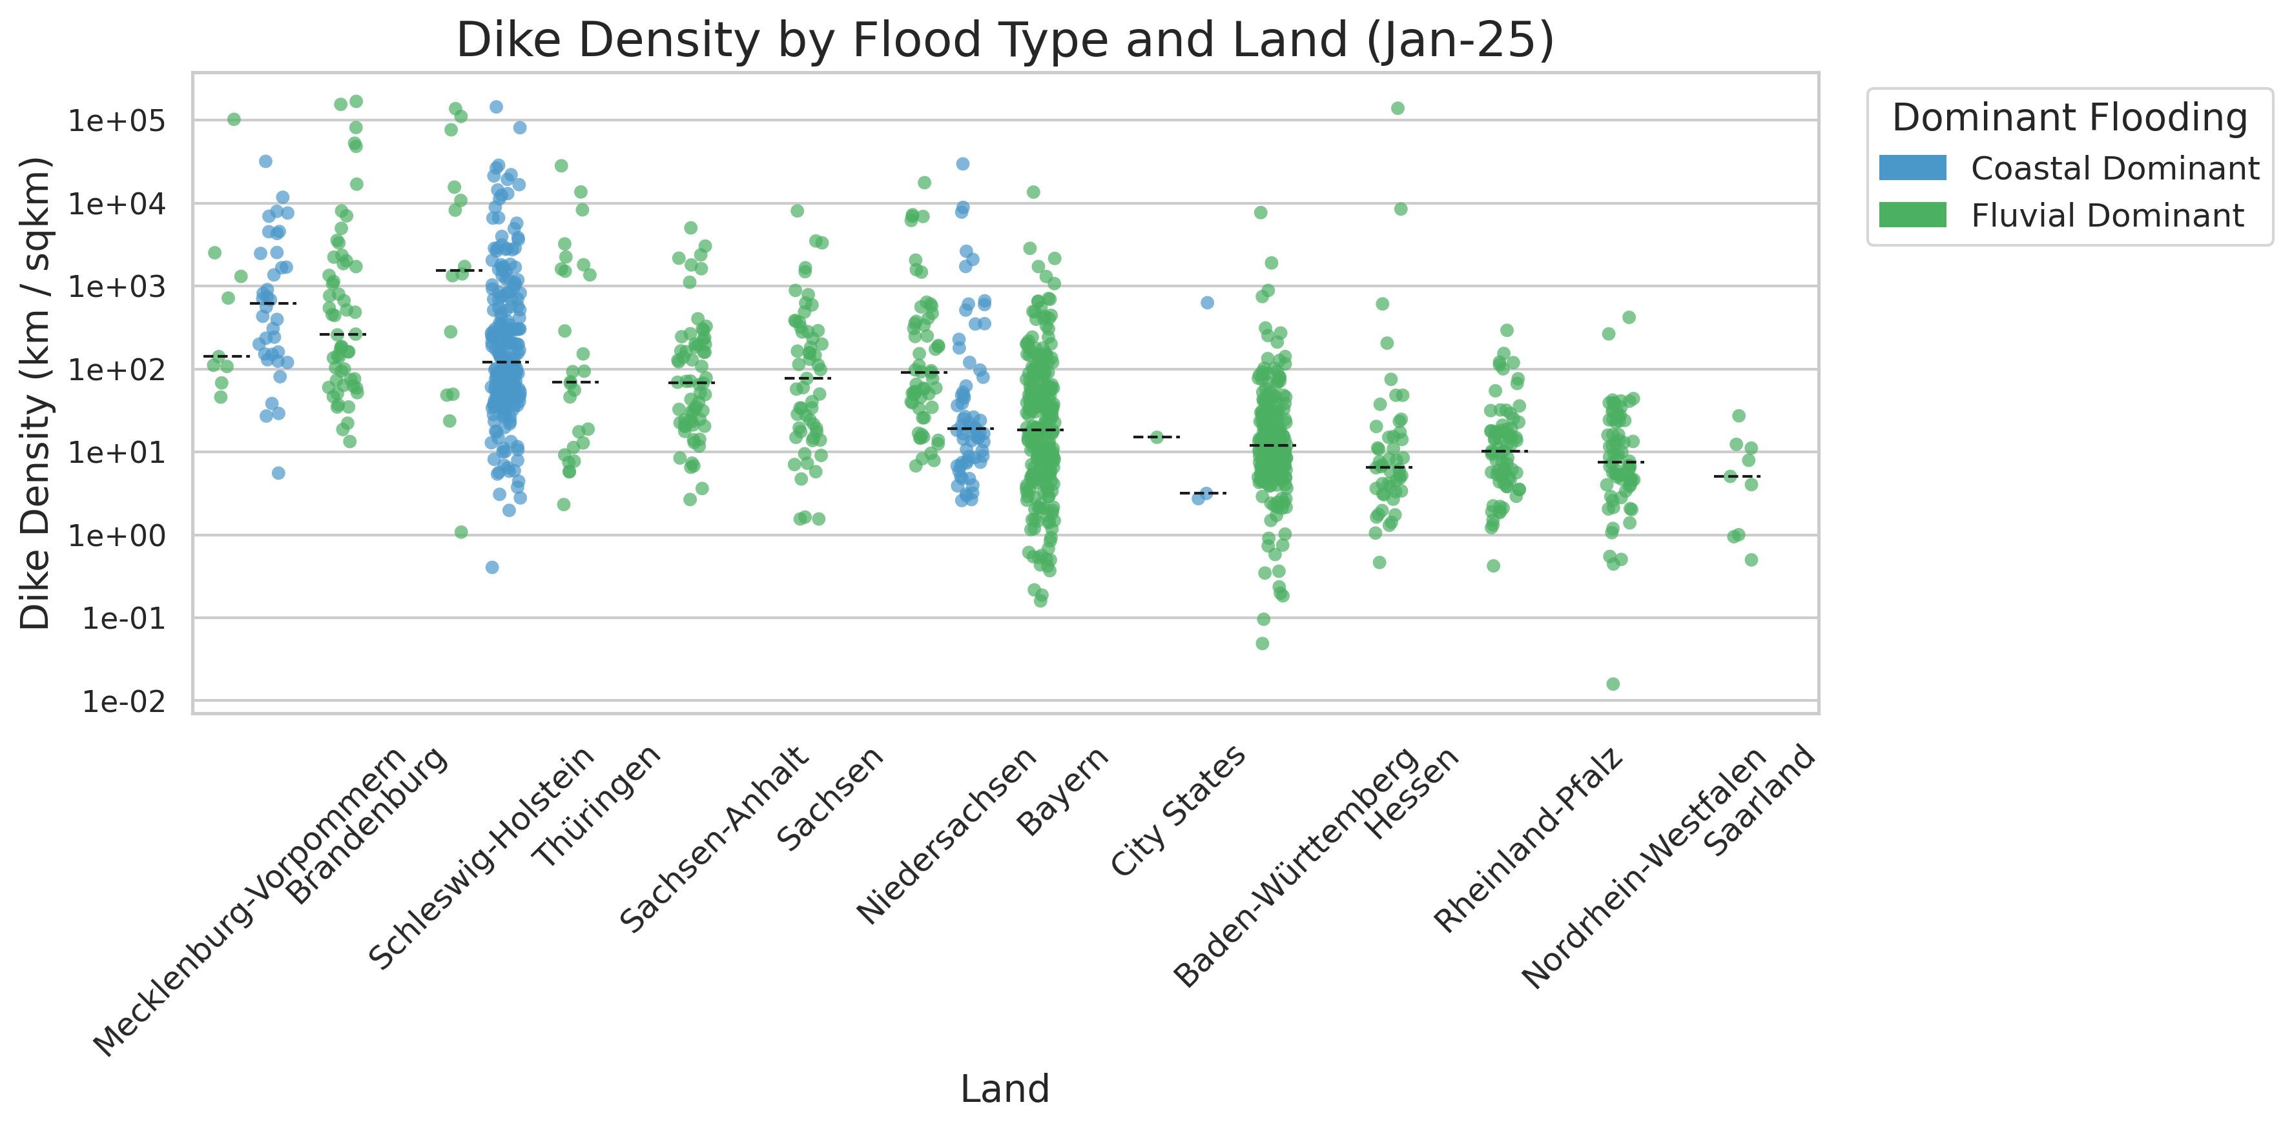
Vertical x labels
Dividing lines between lands
Explain the definition of dike density, protection comparison among different lands km/sq km of exposure, some states have higher protection levels… think about the y label a bit more, maybe just real numbers,
explain the extreme density
City State: Bremen, Berlin, Hamburg

Slide 21
Plot:
Vertical labels on x-axis
Dividing lines between lands
Manually add 75 and 90 percentile lines
Show protection variation within each land by standard deviation (protection variation of fluvial dominant and coastal dominant flooding Gemeinden altogether)
Text: Explain the definition of dike density, protection comparison among different lands km/sq km of exposure, some states have higher protection levels… think about the y label a bit more, maybe just real numbers,
explain the extreme density

Slide 22
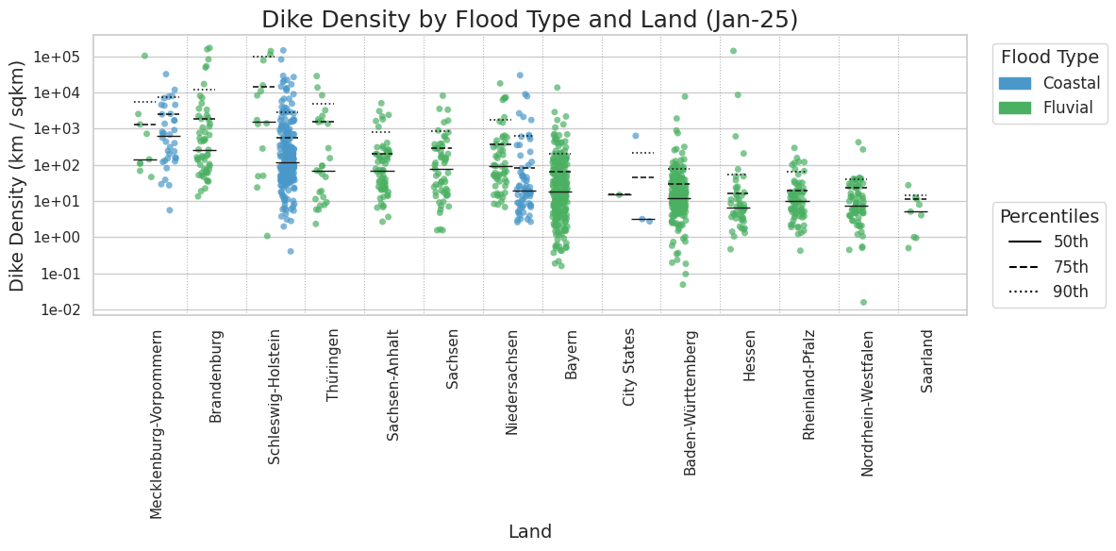

Slide 23
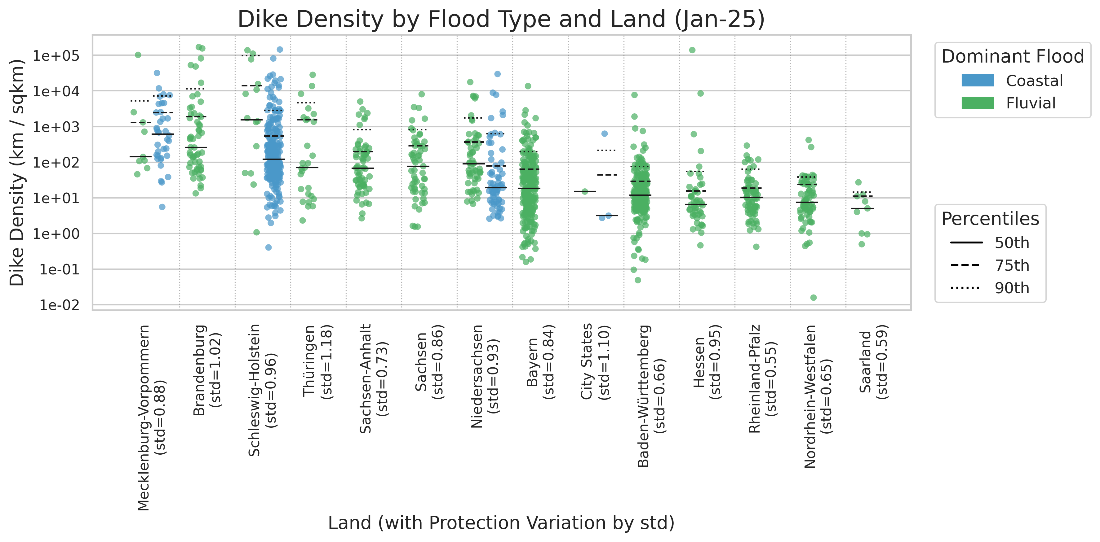

Slide 24
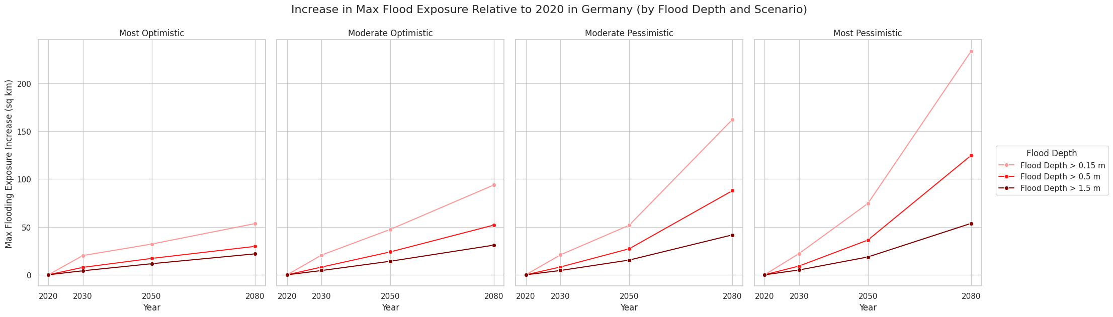
Main paper, pluvial increases the most
(see plot in the next couple of slides for individual flooding type comparison)

Slide 25
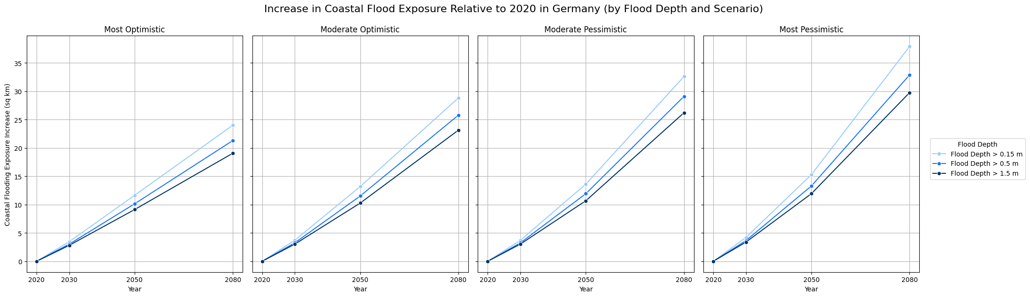
Appendix

Slide 26
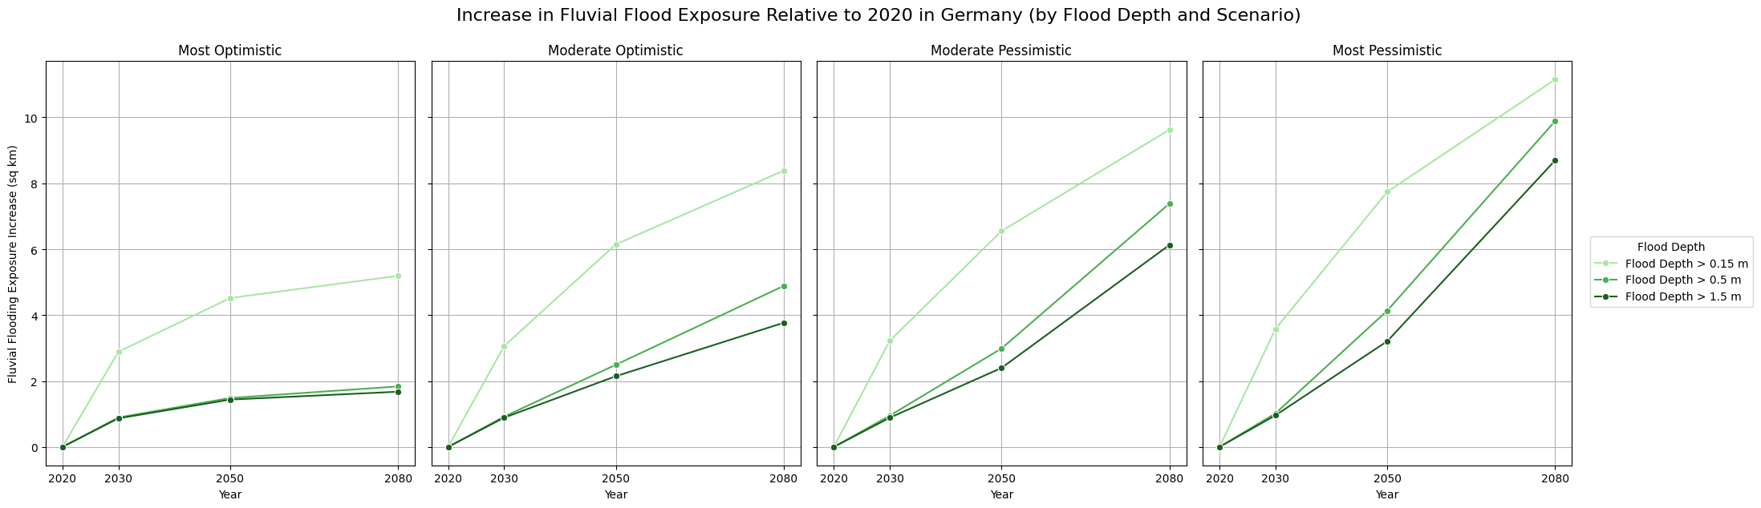
Appendix

Slide 27
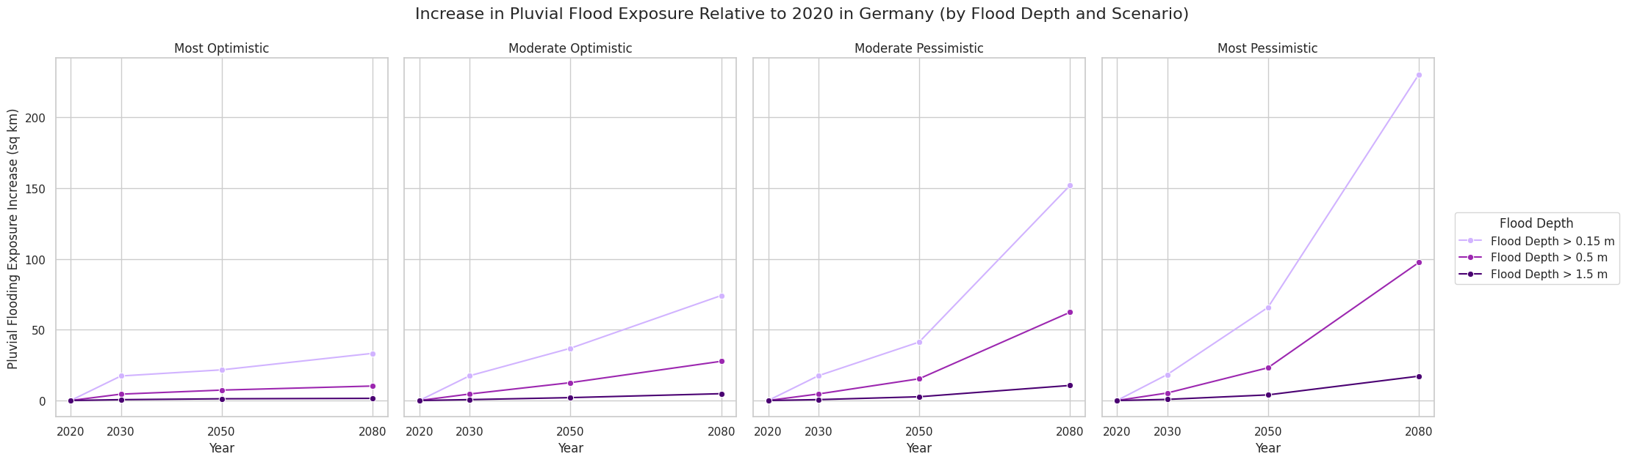
Appendix

Slide 28
Gemeinden level future climate scenario plot:
Stack all scenarios together
Put the unit on the y label (sq km)
Text: Mention the crop of the y axis
Describe how exposure changes when scenario getting worse

Slide 29
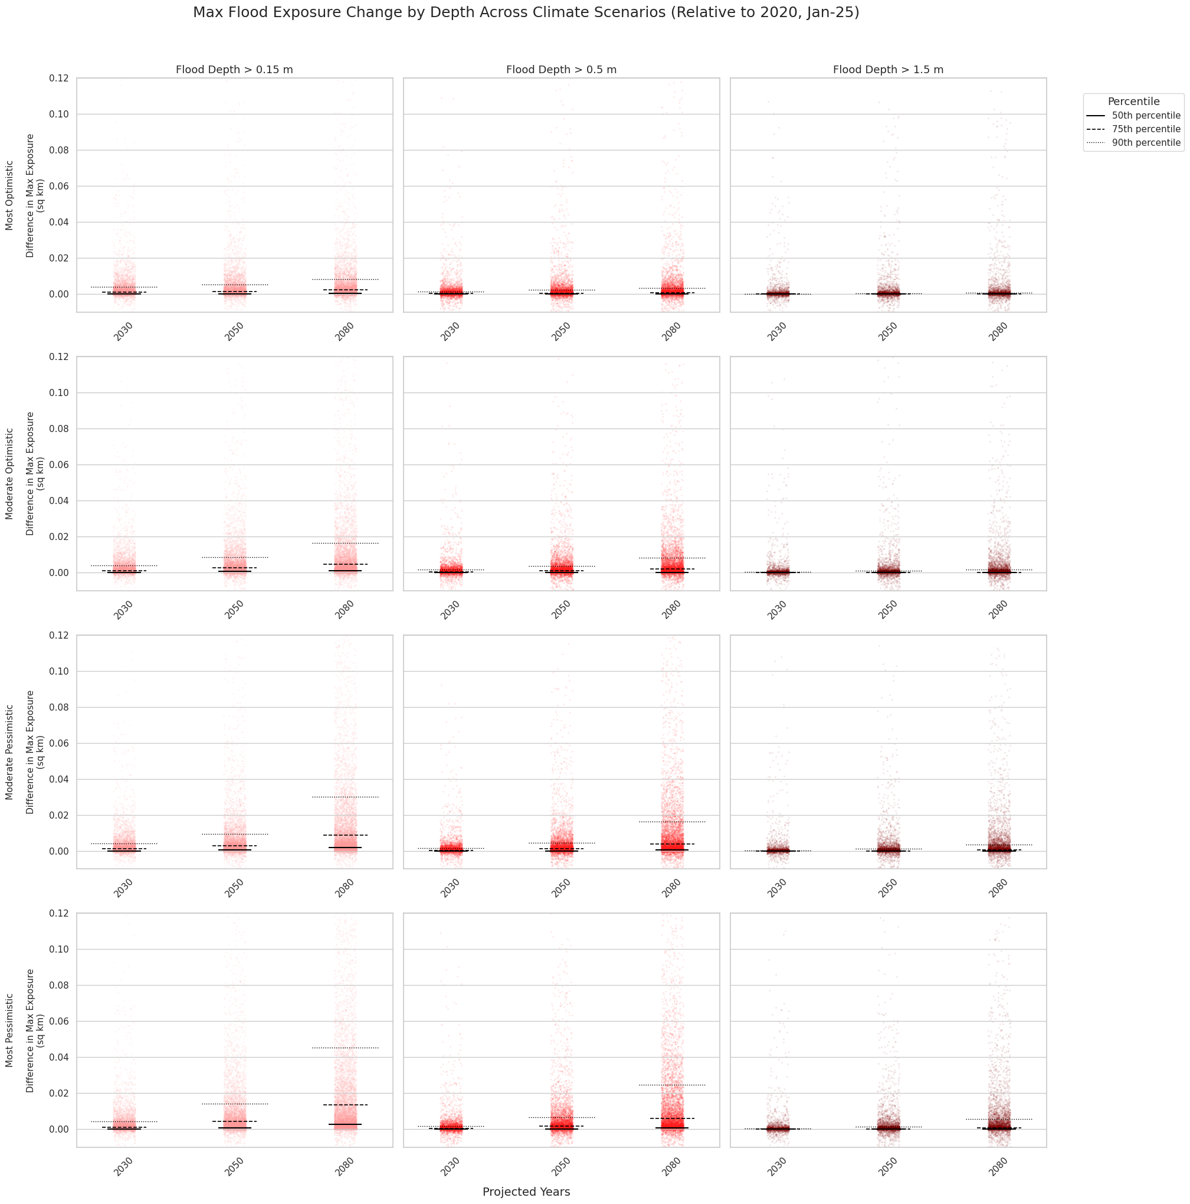

Slide 30
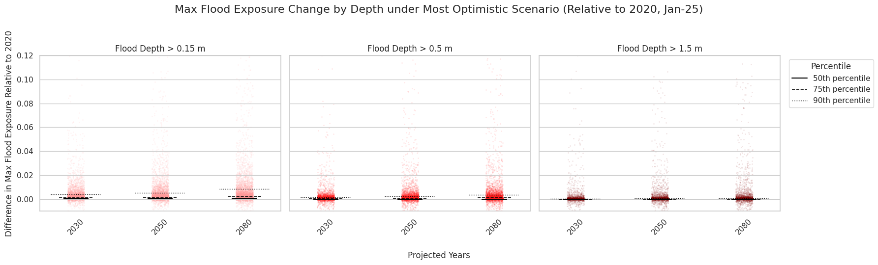
Quantile (>0.15 m) | 2030 | 2050 | 2080
5% | 0.0000 | 0.0000 | 0.0000
10% | 0.0000 | 0.0000 | 0.0000
25% | 0.0000 | 0.0000 | 0.0000
50% | 0.0001 | 0.0002 | 0.0005
75% | 0.0011 | 0.0015 | 0.0024
90% | 0.0040 | 0.0053 | 0.0082
95% | 0.0080 | 0.0110 | 0.0165
99% | 0.0249 | 0.0417 | 0.0778
Mention the crop of the y axis
Describe how exposure changes when scenario getting worse
Stack all scenarios together
Put the unit on the y label sq km

Slide 31
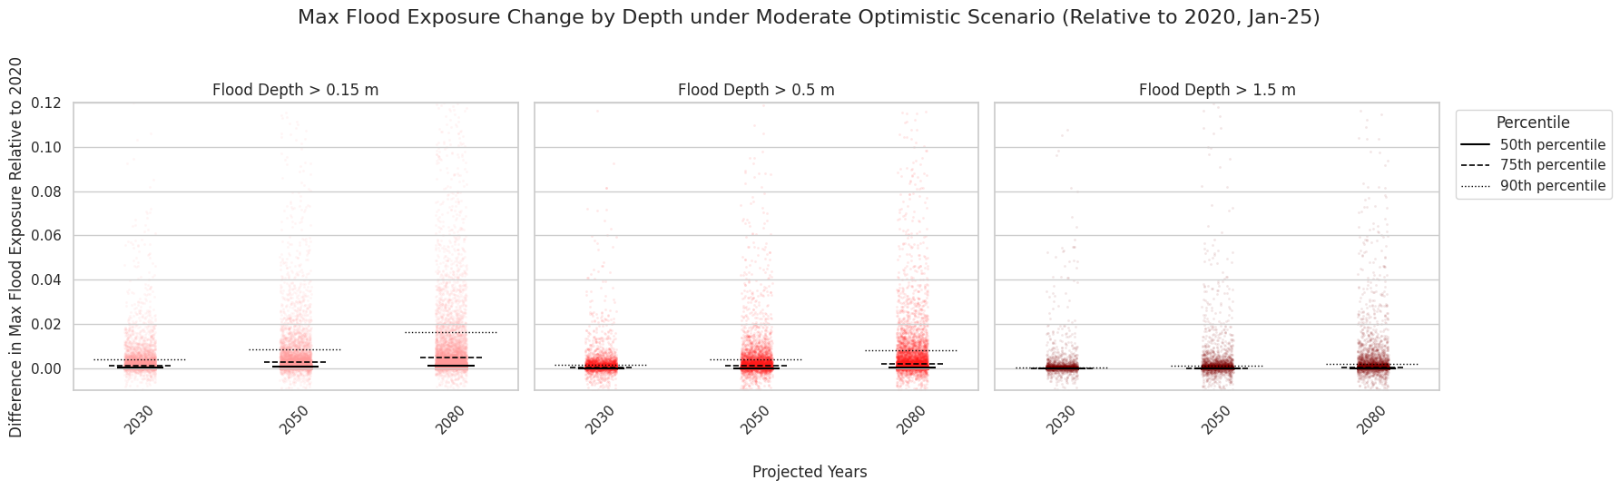
Quantile (> 0.15 m) | 2030 | 2050 | 2080
5% | 0.0000 | 0.0000 | 0.0000
10% | 0.0000 | 0.0000 | 0.0000
25% | 0.0000 | 0.0000 | 0.0000
50% | 0.0001 | 0.0005 | 0.0010
75% | 0.0011 | 0.0025 | 0.0047
90% | 0.0041 | 0.0084 | 0.0163
95% | 0.0082 | 0.0163 | 0.0337
99% | 0.0254 | 0.0645 | 0.1285

Slide 32
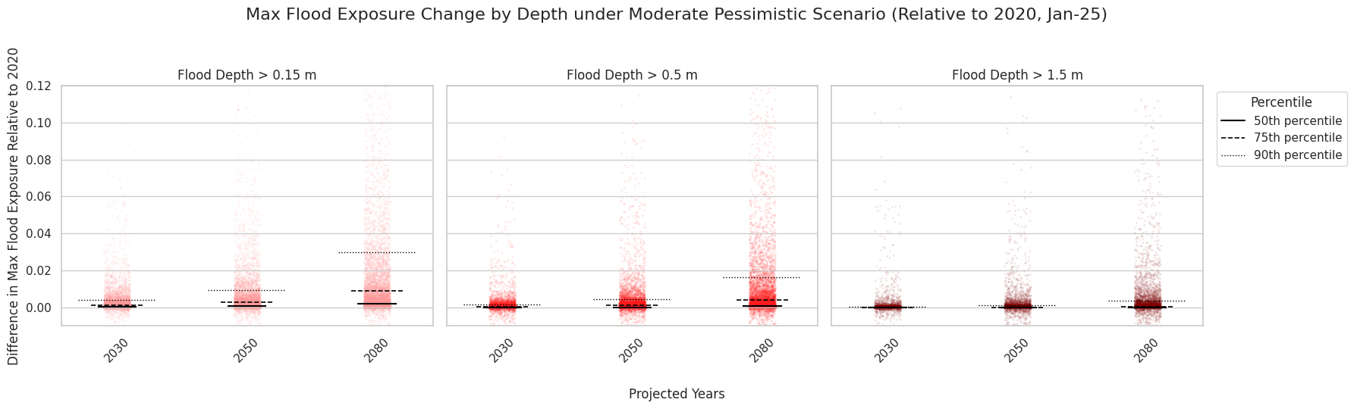
Quantile (> 0.15 m ) | 2030 | 2050 | 2080
5% | 0.0000 | 0.0000 | 0.0000
10% | 0.0000 | 0.0000 | 0.0000
25% | 0.0000 | 0.0000 | 0.0001
50% | 0.0001 | 0.0005 | 0.0018
75% | 0.0011 | 0.0027 | 0.0088
90% | 0.0041 | 0.0093 | 0.0300
95% | 0.0082 | 0.0183 | 0.0620
99% | 0.0255 | 0.0690 | 0.2229

Slide 33
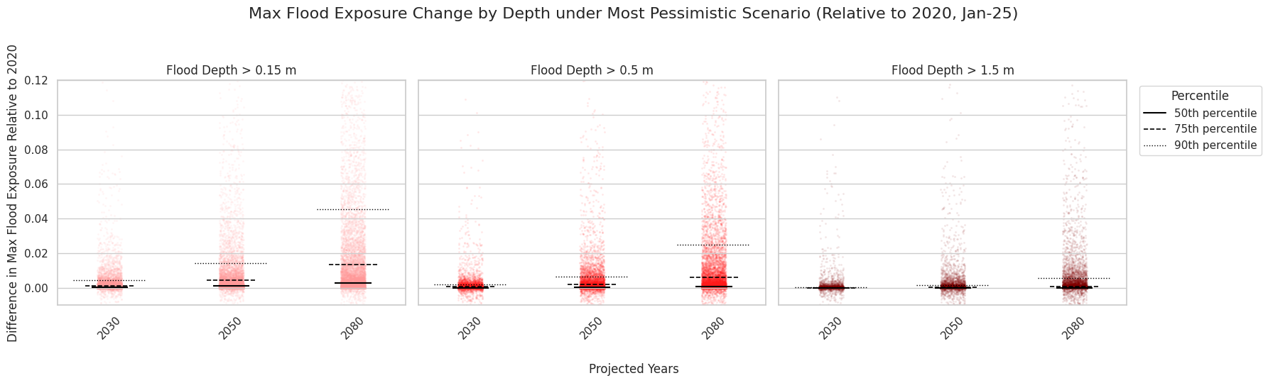
Quantile (> 0.15m) | 2030 | 2050 | 2080
5% | 0.0000 | 0.0000 | 0.0000
10% | 0.0000 | 0.0000 | 0.0000
25% | 0.0000 | 0.0000 | 0.0002
50% | 0.0001 | 0.0009 | 0.0028
75% | 0.0012 | 0.0042 | 0.0135
90% | 0.0043 | 0.0142 | 0.0454
95% | 0.0085 | 0.0280 | 0.0917
99% | 0.0277 | 0.0975 | 0.3131

Slide 34
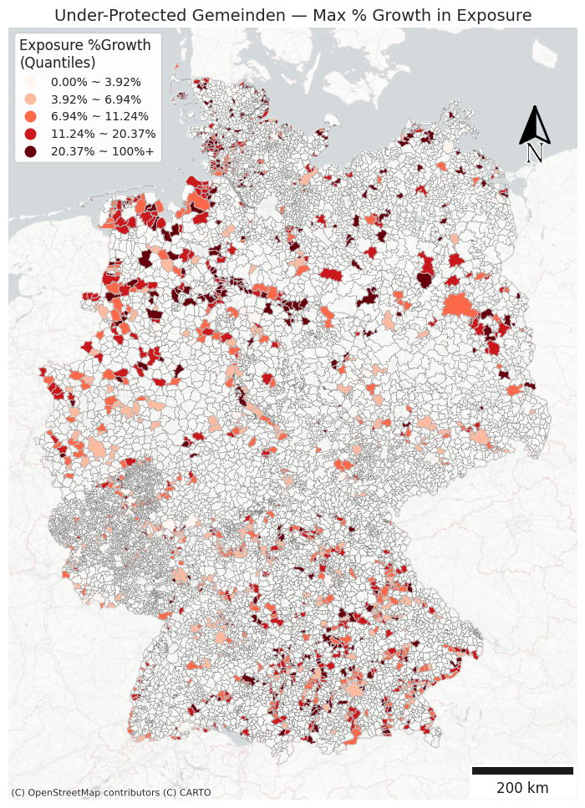
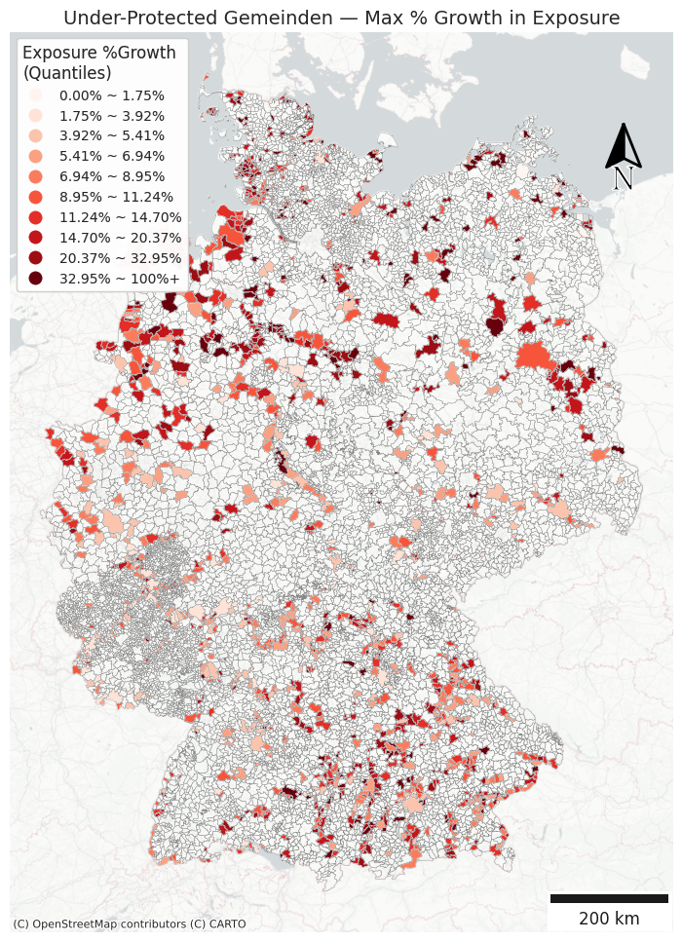
Are we going to use the 5 quantile breaks or customized breaks?
10 quantile breaks may be too many?
Explain how I identified them
Say we should focus on combination of no-protection + high exposure

Slide 35
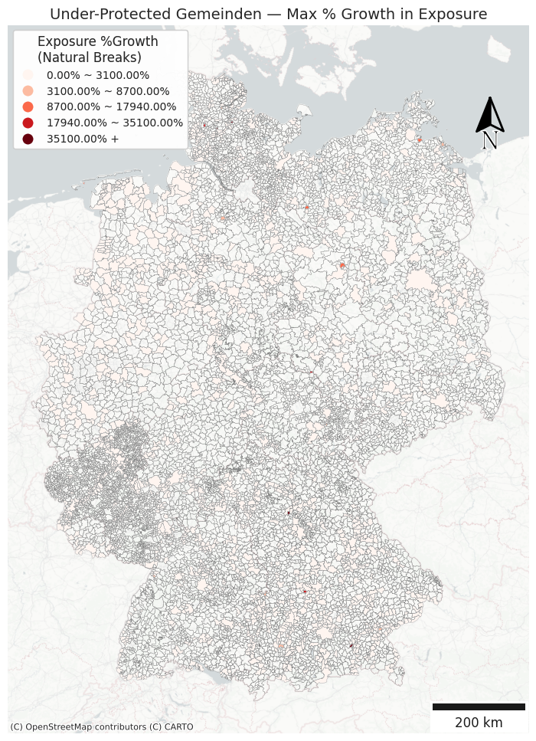
Natural Breaks doesn’t work well for this map…

Slide 36
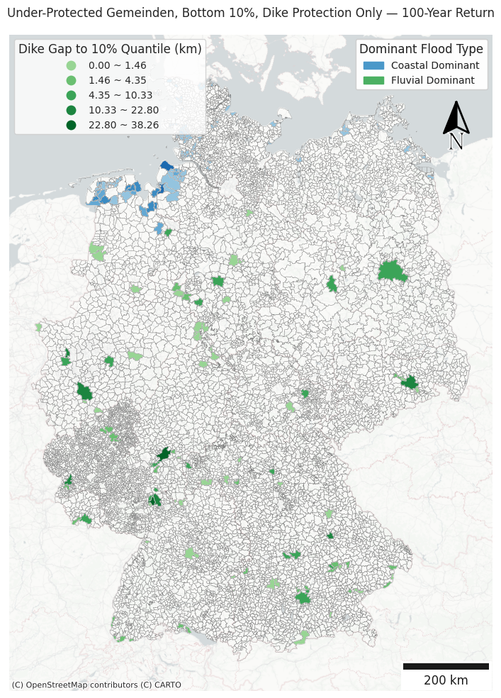
Sum of Dike Length needed = 557.58 km
Describe in text

Slide 37
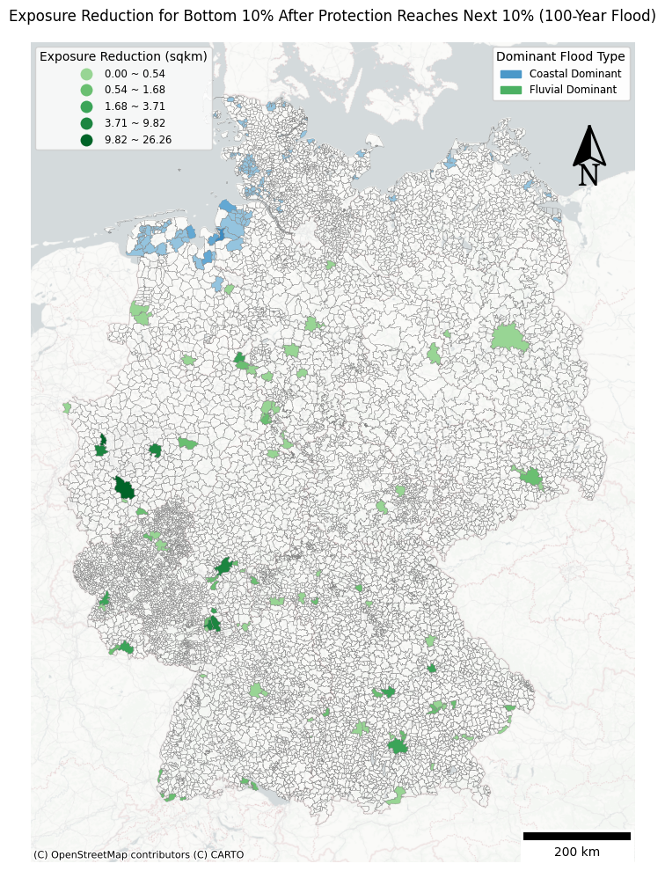
Sum of expected reduced exposure = 159.08 sqkm
Describe in text

